Slide 1
Cross-Industry

Slide 2
Contents
Scenarios
Employee Check-in Check-in with location and time for employees
Meeting Manager Conduct effective meetings with your teams
Employee Onboarding Enhanced Customer Support
For each scenario:
Scenario Vision
Primary Persona
Scenario Storyboard
Solution Design Best Practices
Solution Architecture

Slide 3
Employee Check-in
Cross-Industry Book of Dreams

Slide 4


Scenario Vision
Employee
Context
Babak newly joined Contoso and is figuring out the new tools and systems he has to get familiarized with. One of the daily activities expected of Babak is sharing the time of check-in and check-out with his immediate manager
Babak’s team works with multiple customers in different locations and this frequently takes Babak across cities or to different offices within his base city. Consequently, Babak is expected to check-in and check-out from whichever location he is in.
Current State
Employees have to login to a check-in portal within Contoso’s intranet at the start and end of shifts. Logging in via mobile is not supported
Once logged in, employees have to enter the time in the right date column and pick and choose their location from an address search bar.
There are no auto reminders for each timesheet entry due to fear of spamming on e-mails. However, employees get a missed check-in e-mail one day after missed check-in
Managers are expected to download the check-in information of their team members as an excel and do further analysis on the same.
In order to add / remove a team member, managers are required to send an e-mail request to IT team who will perform the addition / removal with 4 working days.
Future State
The app proactively nudges employees to perform a check-in / check-out at the beginning and end of their shifts.
Check-in or check-out can be performed using any device, mobile, desktop or web browser. The user experience remains the same.
The app employs single sign-on and persists the login information. The employees do not have to sign in every time to access the app
Managers get a single consolidated view of their team’s time entry information. This view is customizable and allows for exporting info.
Managers can add or remove team members whose information they would like to see in the app. The app handles it by sending an accept or reject requests to the team member and adds them to manager’s dashboard
- Points of Friction

Slide 5

Babak Shammas, Developer
Babak is a developer in Contoso. He has recently joined the organization and will be working as part of Daniela’s team. Babak is enthusiastic about kickstarting his day to day tasks. He feels bogged down by the multiple internal tools & processes he has to get familiarized with purely for admin and reporting purpose.

Slide 6
Babak gets a notification from the Check-in app prompting to sign in and provide check-in information.

Slide 7
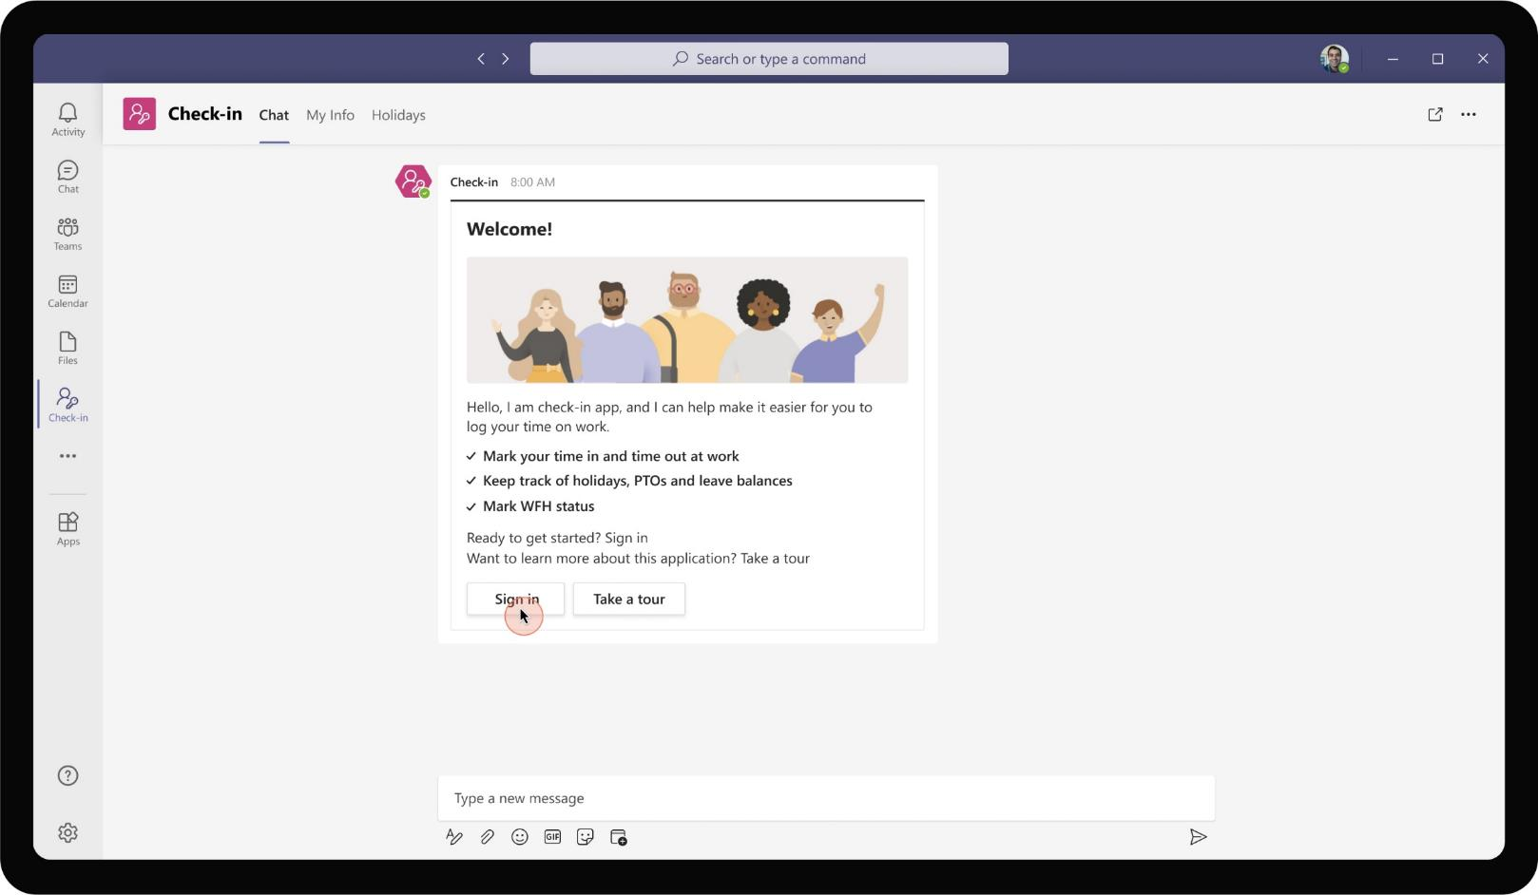
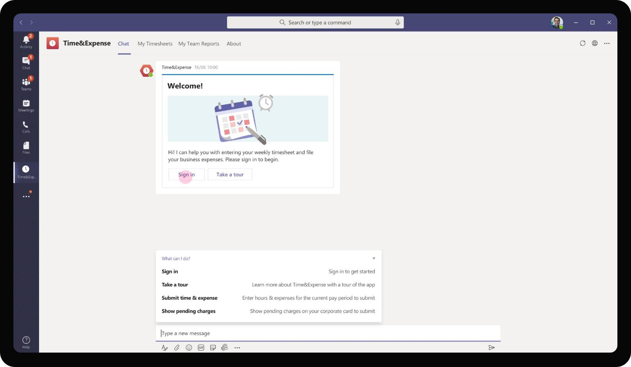
Cross-Industry– Employee Check-in
As the app is added, it presents a welcome card walking Babak through the various features available as part of Check-in app. It also directs Babak to sign-in to start using the app. The Take a Tour button opens a task module with video walkthrough of various features of the app.

Slide 8
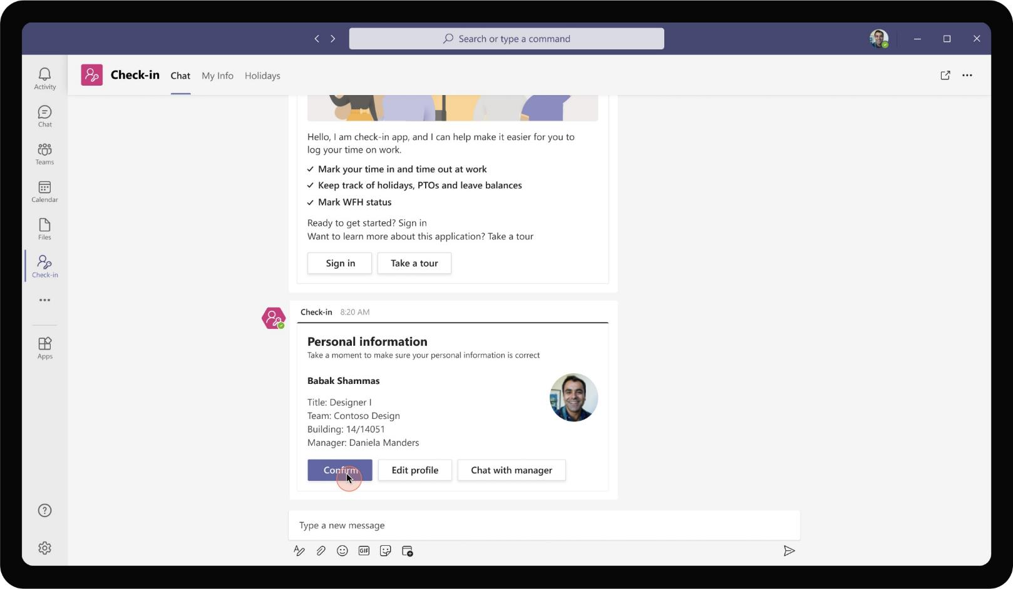
Cross-Industry– Employee Check-in
On signing in, Babak is provided with a summary information of his profile indicating his role, manager and location in office. This will be used for location based check in and for providing aggregated information to manager.

Slide 9
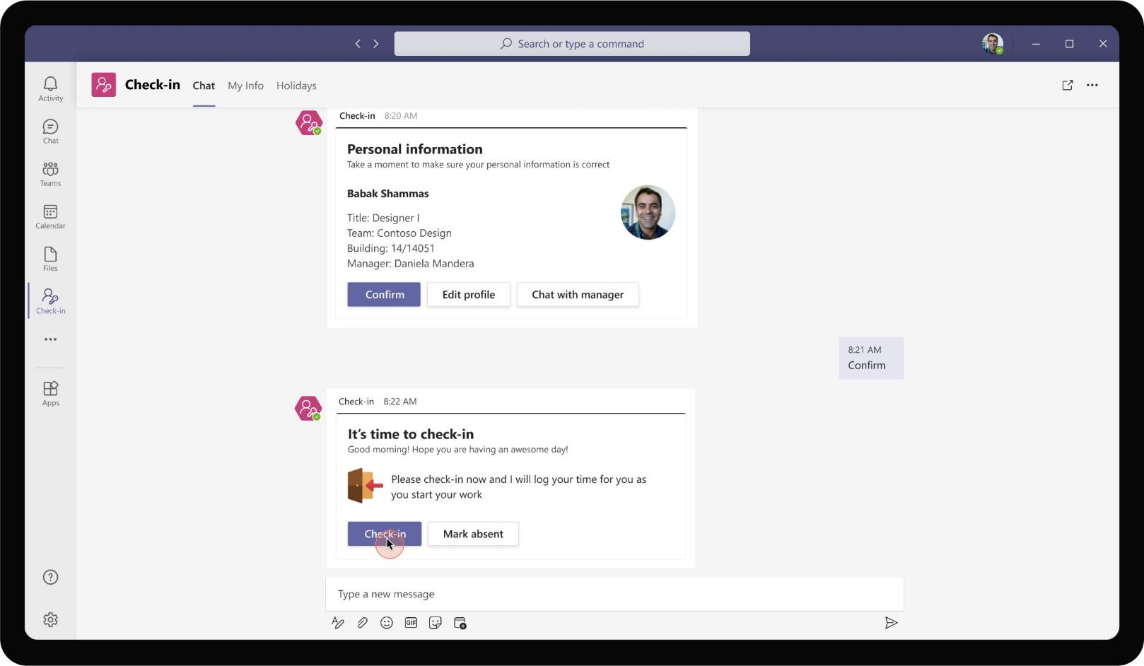
Cross-Industry– Employee Check-in
As Babak confirms the information shown on the adaptive card, the app prompts Babak to perform his first check-in. In case, Babak is taking the day off, he can also mark himself absent directly from this card instead of check-in

Slide 10
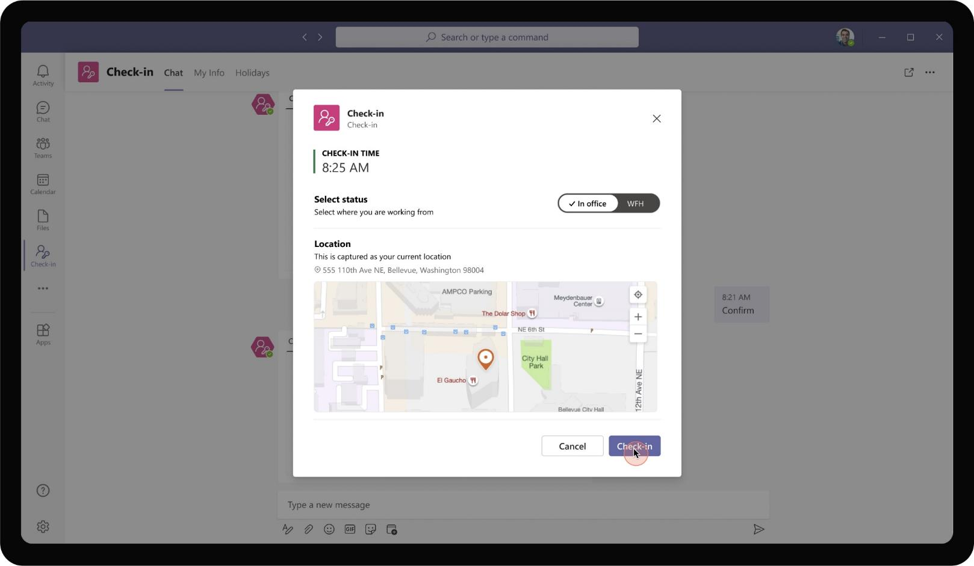
Cross-Industry– Employee Check-in
On clicking check-in, a task module opens up and captures Babak’s current location showing it in a map format for Babak. Babak is able to toggle between WFH and in office working. Location capture gets switched off in WFH check-ins to ensure user privacy.

Slide 11
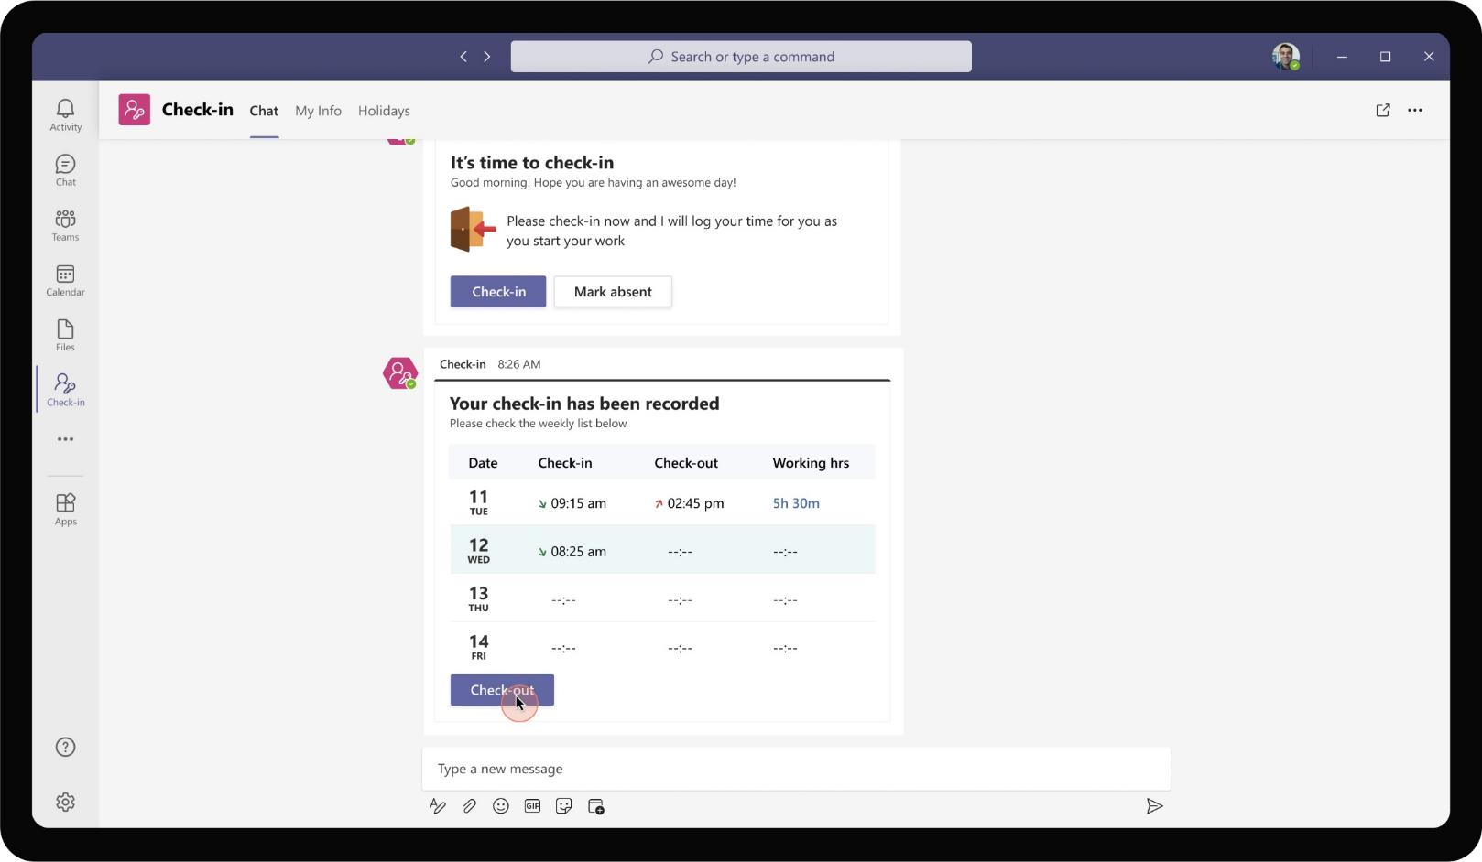
Cross-Industry– Employee Check-in
As check-in is recorded, the app sends an adaptive card marking the check-in time for the day. It also shows the week’s check-in and check-out timing for Babak’s quick reference.

Slide 12
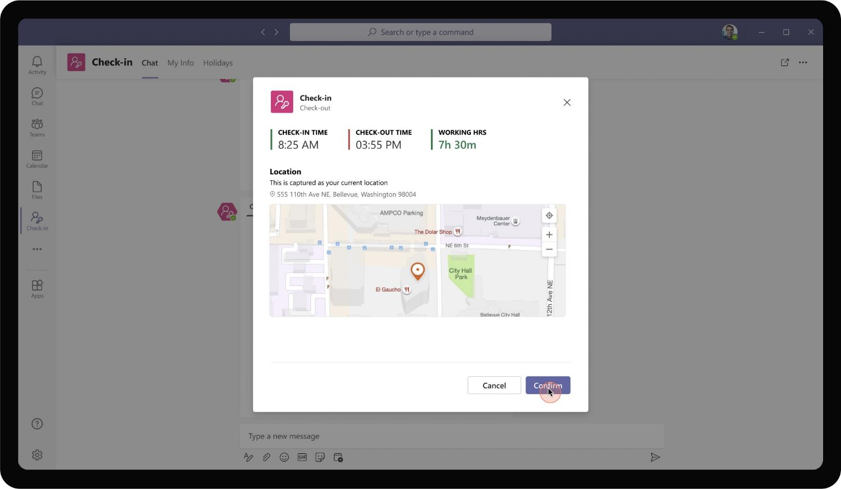
Cross-Industry– Employee Check-in
Nearing end of his shift, Babak can use the same card to perform a check-out. Check-out also captures user location and the time of check-out.

Slide 13
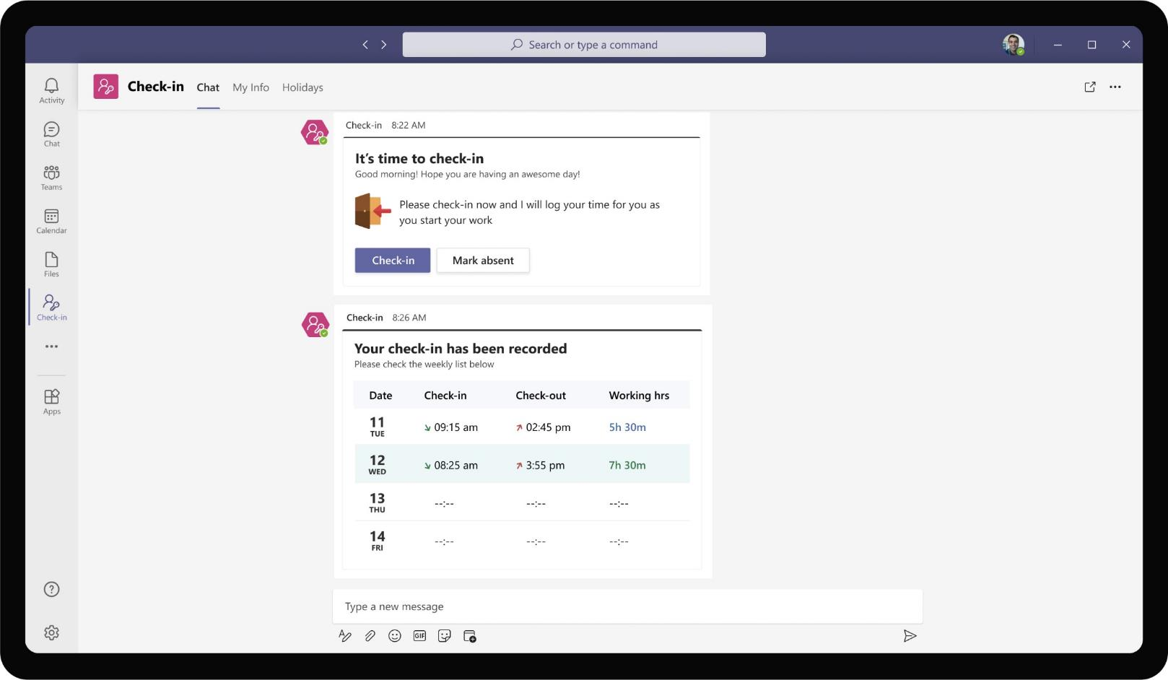
Cross-Industry– Employee Check-in
The same adaptive card gets refreshed to show the checked-out time and automatically calculates the working hours for Babak for that day.

Slide 14
As all team members check-out for the day, the team manager, Daniela Mandera is able to view the time reports in one consolidated view

Slide 15
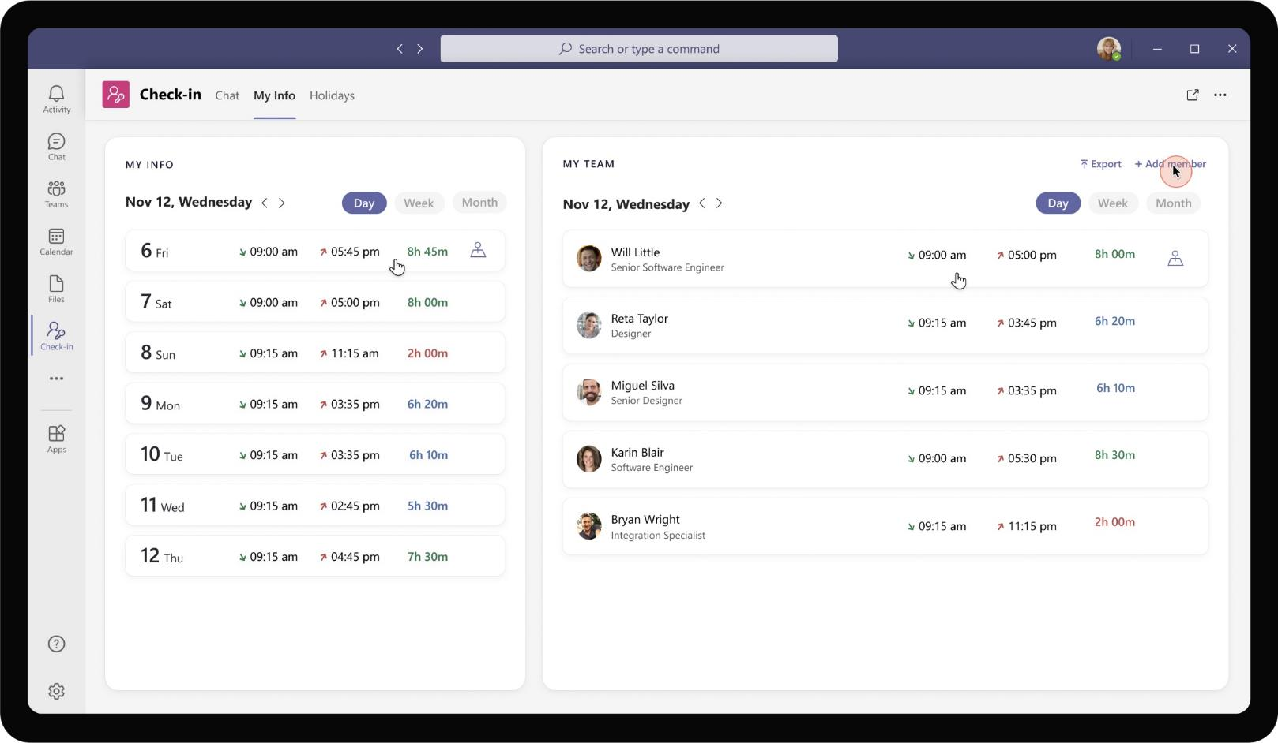
Cross-Industry– Employee Check-in
Daniela’s My Info tab shows her own timesheet, check-in information on the left side. On the right pane, she is able to see the check-in timings of her team members. Daniela chooses to add an additional team member, Babak, who recently joined the firm.

Slide 16
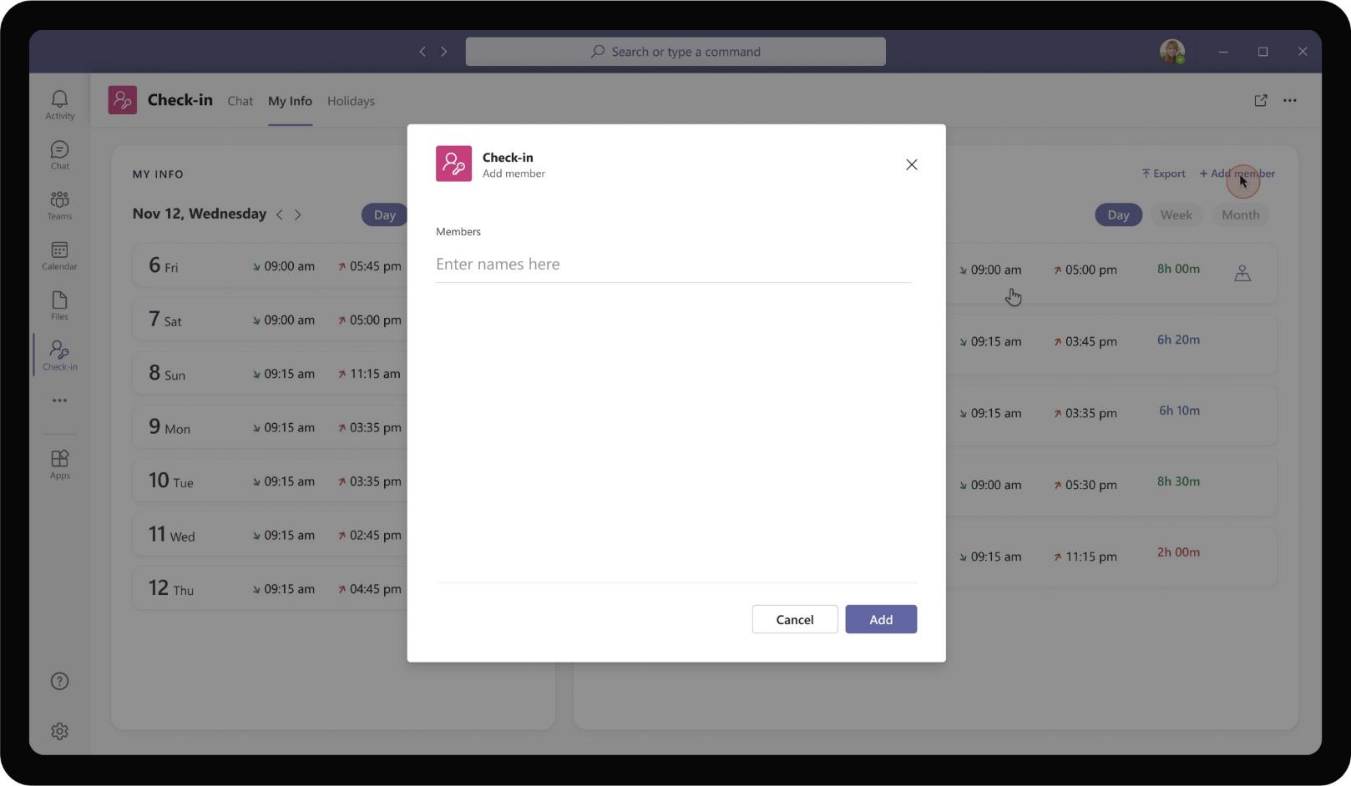
Cross-Industry– Employee Check-in
Clicking on add members, opens a task module that allows Daniela to search for a user within the organization.

Slide 17
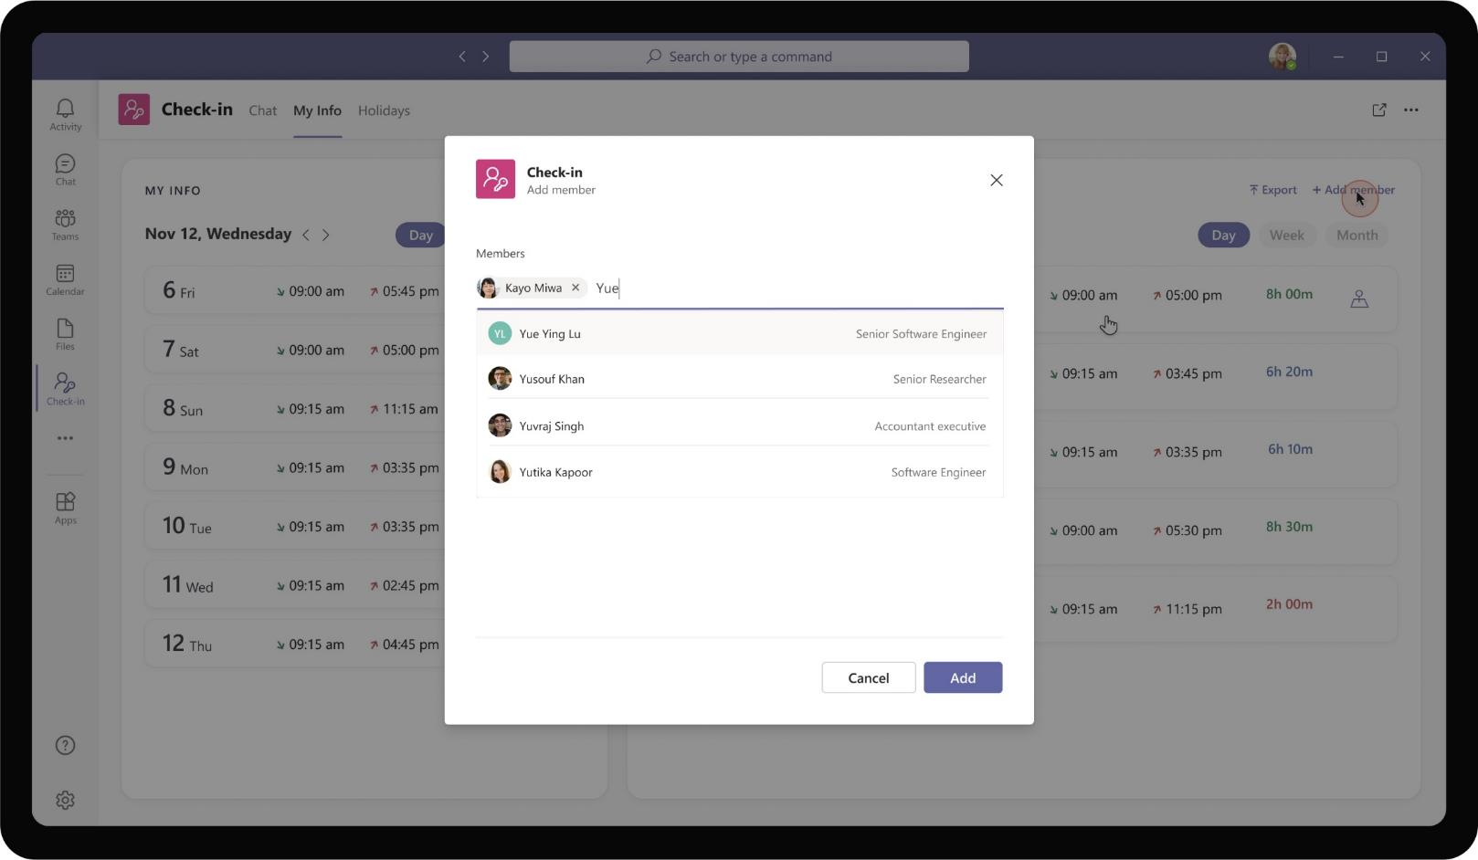
Cross-Industry– Employee Check-in
She is able to type in names of employees who should be added to her dashboard view.

Slide 18
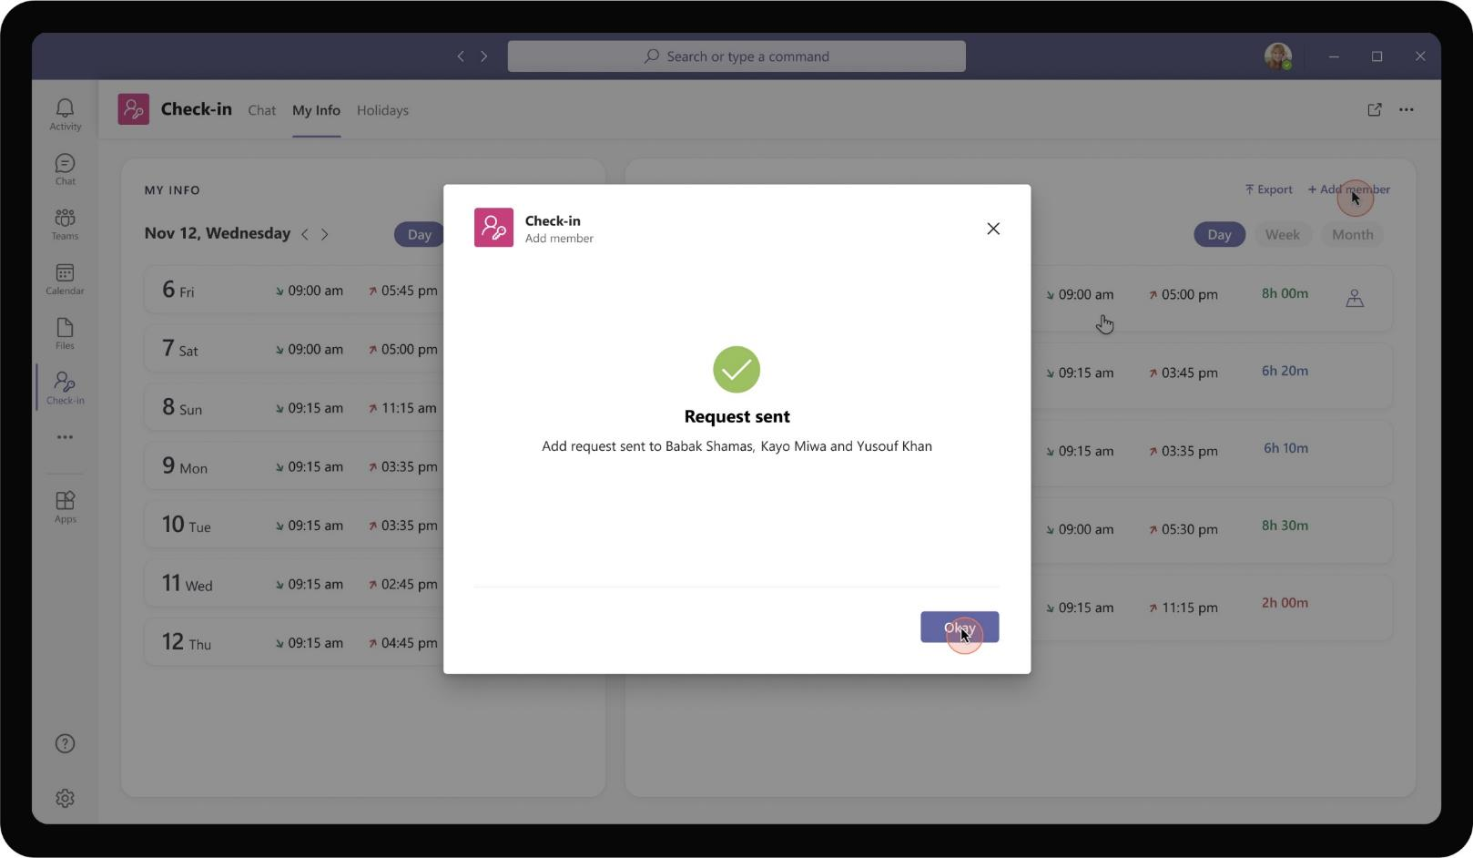
Cross-Industry– Employee Check-in
Daniela sends the add request to Babak and two other employees who newly joined her team.

Slide 19
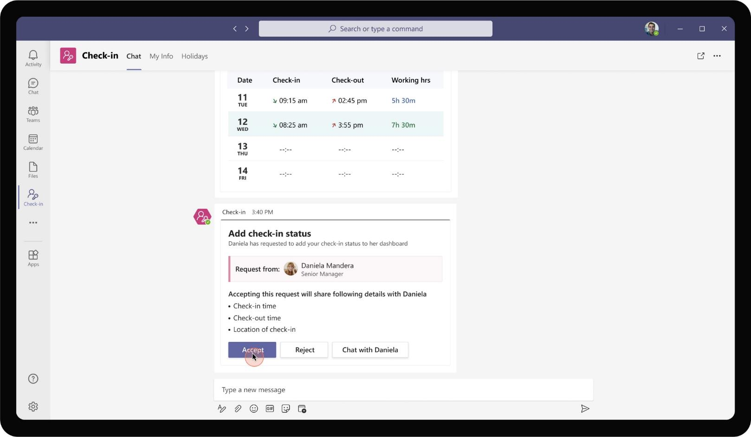
Cross-Industry– Employee Check-in
Babak receives a notification on his app informing of Daniela’s request. The card also clearly points out the information that Babak will be sharing with Daniela if he clicks on accept.

Slide 20
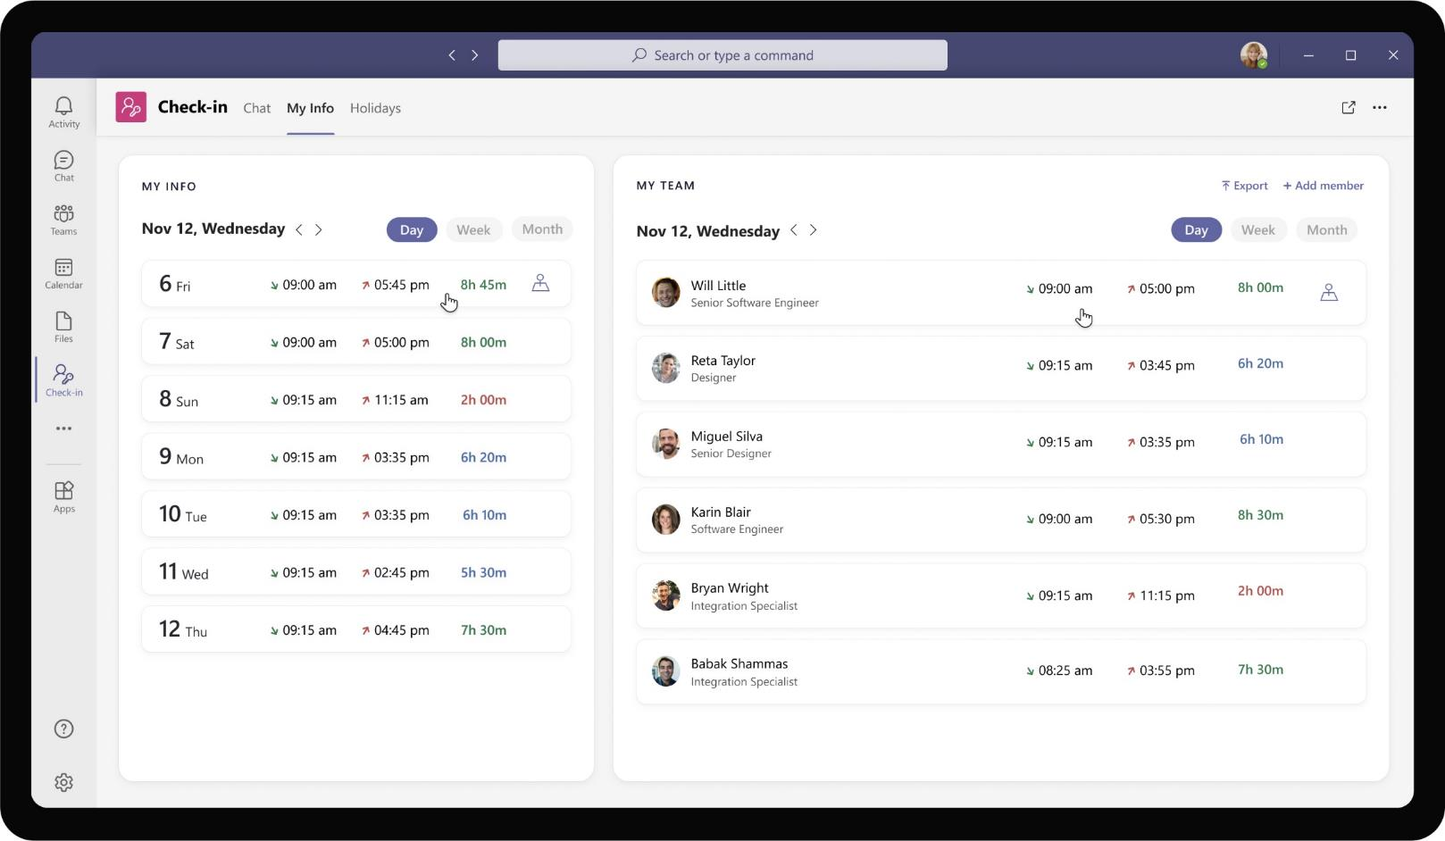
Cross-Industry– Employee Check-in
As Babak accepts the request, his check-in and check-out information gets added to Daniela’s view. Daniela has the option to view the information at different levels of aggregation – day, week or month.

Slide 21
Solution Highlights – Best Practices
Cross-Industry– Employee Check-in
Key Solution Design Considerations
Platform Extension Points
User Experience
Personal Scoped App The app is completely personal scoped because marking check-in information, absence are private information between employee and possibly the manager. There is no team collaboration required here
Personal Tab – Personal tab is mainly used for providing dashboard view of check-in / check-out information and to perform preliminary analysis, cycle through dates
Personal Bot – Personal bot handles the heavy lifting of capturing check-ins. Bot serves the purpose well as it comes with added benefit of nudging employees at scheduled time to take action
Task Modules are used for the actual part of check-in primarily due to the map / location feature. Capturing location is possible via task modules / tabs only. Having an interactive map is also feasible in a task module which allows for embedding an iframe.
The app uses Adaptive cards for displaying persistent messages only and not intermediary steps. The adaptive card shows the checked-in and checked-out timing as a persistent info and not intermediary steps of marking check-in
Card refreshes are used to update the card status instead of sending multiple different cards about the same request. This ensures that readability is easier, and app does not spam with multiple cards for updates.
Proactive Messages are sent at the start and end of each day to remind employees to perform a check-in
Graph API
The app uses Get Photo Graph API to capture the profile pictures of users from AAD Profile
In order to fetch the employees to be added to team, app leverages the people picker component

Slide 22







Solution Architecture
Cross-Industry– Employee Check-in
Azure Subscription
AAD
External Systems
SSO and Reporting org
Bot / Task Module / ME
Employee check-in info, bot CTAs
Employee Database
Employee
MS Teams
Bot Registration
Check-in
App Service
Read check-in info & emp details
GET check-in time info
Check-in information
Archive Database
Client App (my Info Tab)
Check-in database

Slide 23
Meeting Manager
Cross-Industry Book of Dreams

Slide 24
Scenario Vision
Employee
Context
Daniela is a manager at Contoso Services. She manages a cross-functional team of employees and juggles between responsibilities across different product areas
She uses a multitude of tools to keep in track of her project goals across different teams, outcomes from meetings, action items and notes. While it works to a certain extent, these systems seldom talk to each other causing switches and silos of info
Current State
Daniela sends a recurring meeting invite to members of her team with a fixed agenda in an email
As all members join the meeting, Daniela kickstarts the meeting by sharing her screen with agenda.
Notes and action items discussed during the meeting are captured separately by Daniela on the side
She collates the notes after the meeting is over and posts it as a reply email to the meeting. She sends action items also as a separate section in the same email with the names of owners mentioned
In subsequent meetings, Daniela shares her screen again to go through each action item and updates manually when she gets confirmation that a task is complete by the owner.
Keeping track of recurring tasks, tasks open for a while have been a challenge and need to be addressed separately
Future State
Daniela initiates a meeting and adds the agenda, any required pre-reads along with the meeting invite
Prior to the meeting, she gets to see any previous action items discussed, notes and agenda.
During the meeting, there is a shared collaborative space for all attendees to capture notes and store in a common OneNote
All action items that were discussed during the meeting can be easily tracked as tasks.
Tasks can be instantly created from the meeting side panel, assigned to right owners, updated on completion without switching context from meeting
Daniela is always on top of team’s progress towards project plan, goals with minimal efforts from her end.
- Points of Friction

Slide 25

Daniela Mandera, Manager
Daniela is a manager at Contoso Services. She leads a product line and regularly works with cross-functional team of employees.

Slide 26
Daniela recently won a project opportunity with a Client. She wants to kickstart a daily standup meeting to discuss about the project, goals, and track progress until completion

Slide 27
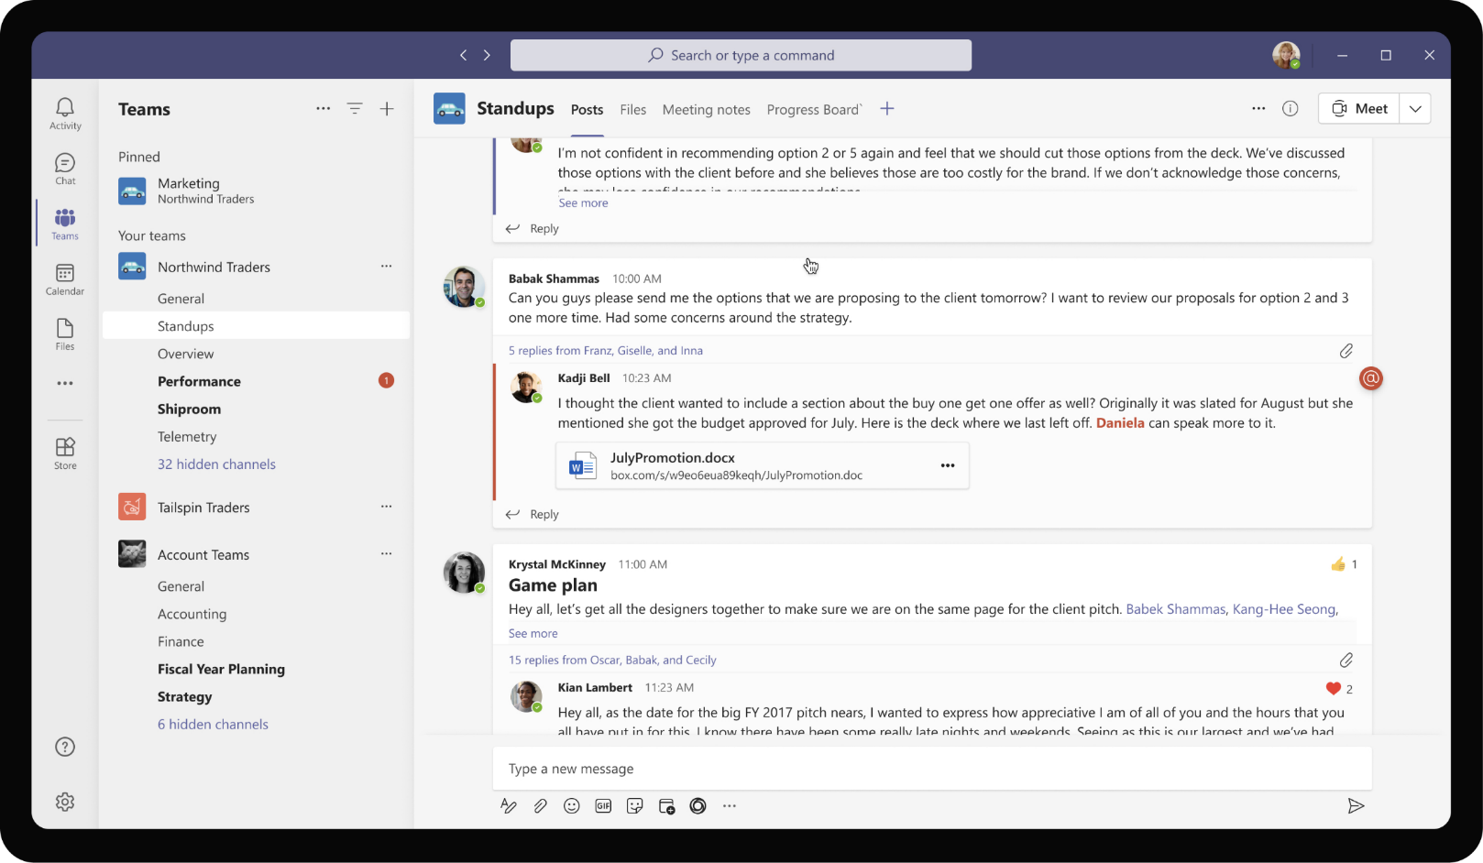
Cross-Industry– Meeting Manager
Meetings can be invoked from any context. Daniela is part of a Team and channel going through conversations. She remembers to setup a regular standup meeting for her team and chooses to do so from the messaging extension.

Slide 28
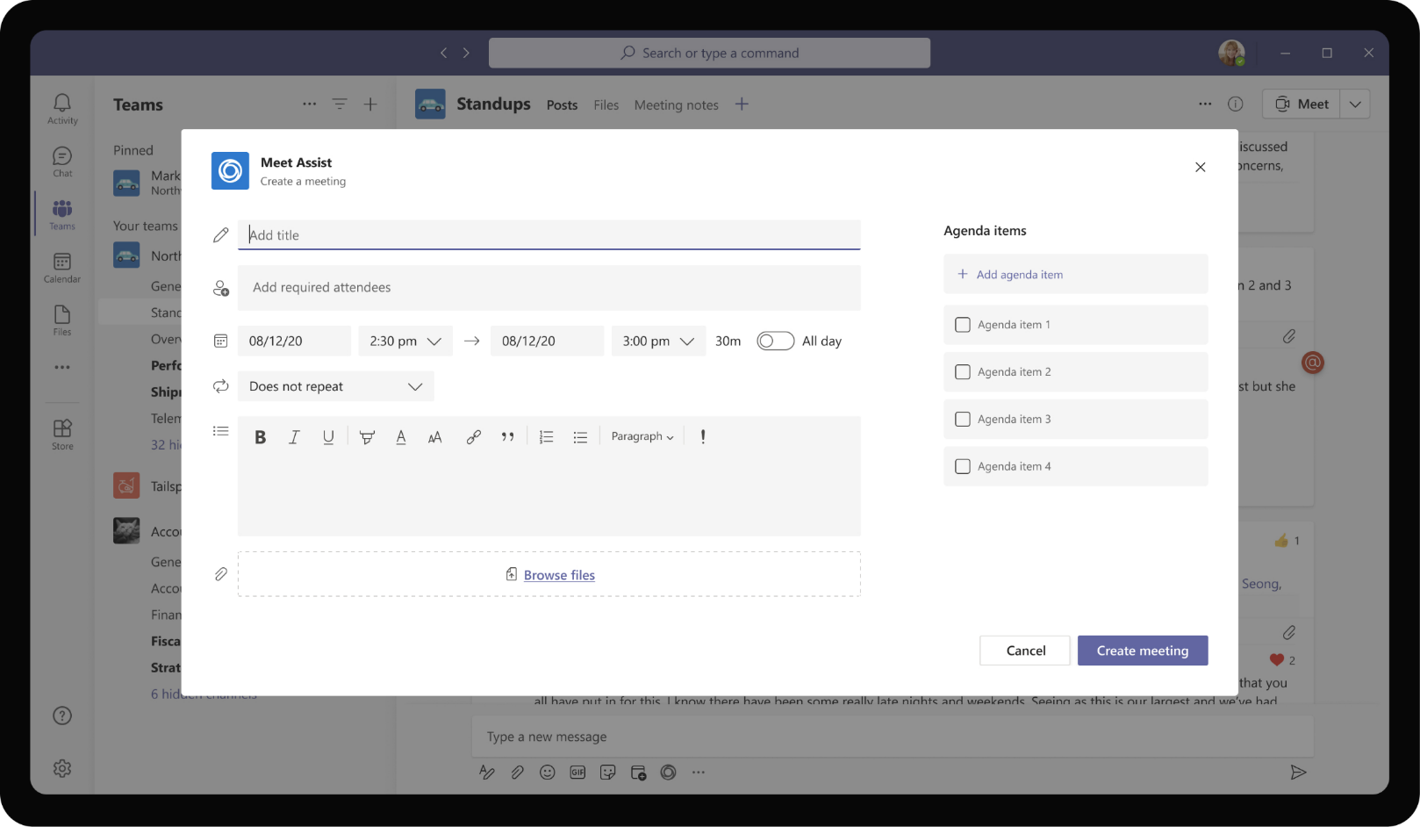
Cross-Industry– Meeting Manager
Clicking the messaging extension opens a task module with text boxes that allow Daniela to enter relevant information for a Teams meeting.

Slide 29
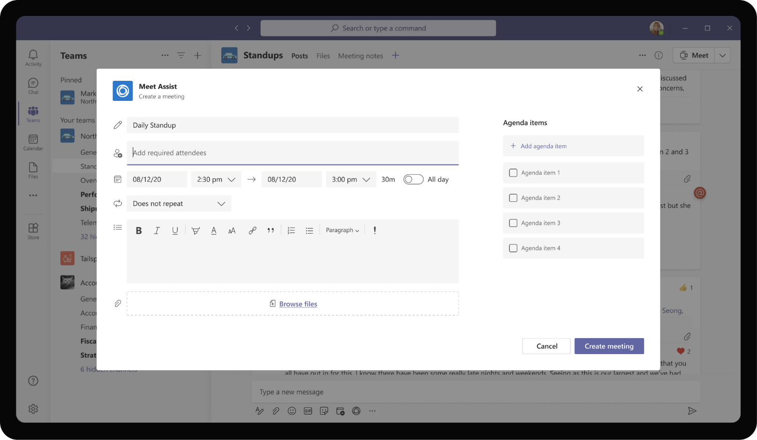
Cross-Industry– Meeting Manager
Daniela proceeds to enter meeting name ands time.

Slide 30
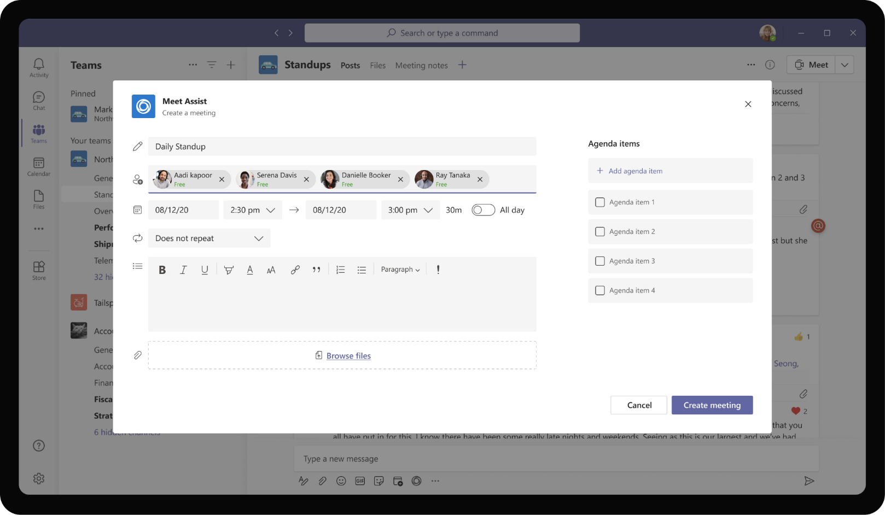
Cross-Industry– Meeting Manager
She also adds her team members who should be part of daily stand up meeting.

Slide 31

Cross-Industry– Meeting Manager
The app provides option to set the recurrence of the meeting as well.

Slide 32
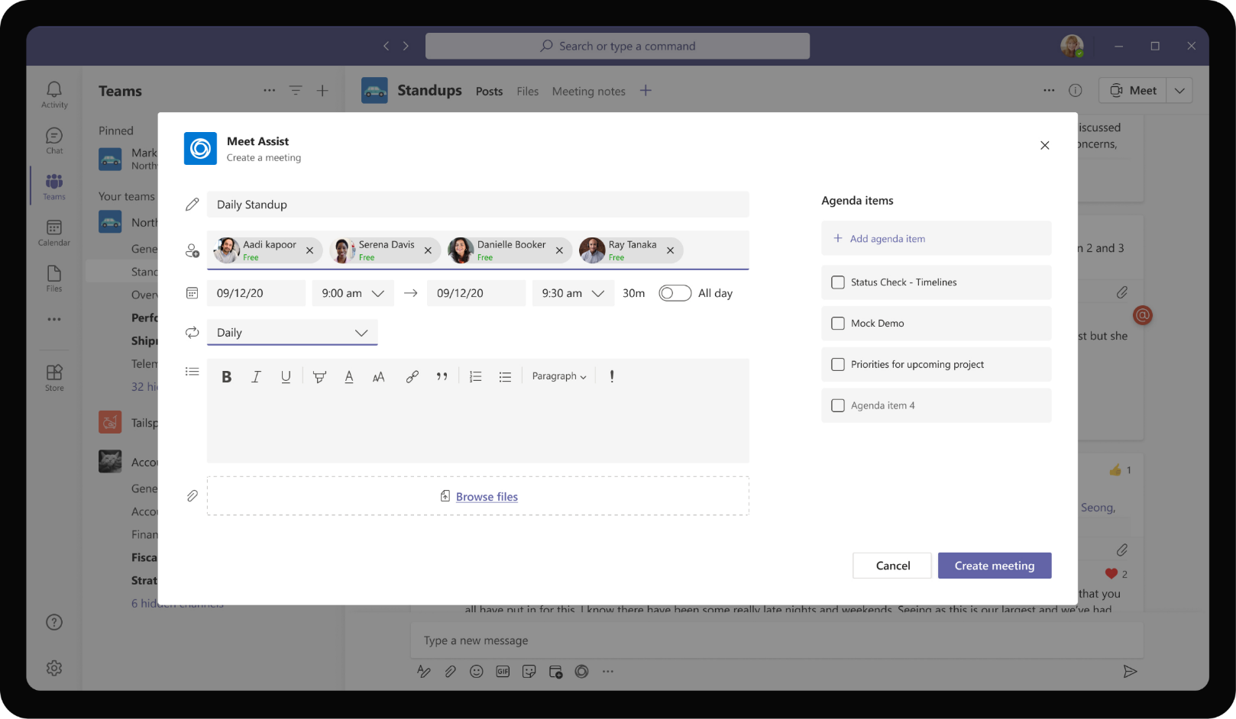
Cross-Industry– Meeting Manager
As a final setup, Daniela fills in the optional list of agenda items to be discussed in the meeting. Daniela proceeds to create a meeting after adding agenda items.

Slide 33
On the day of meeting, Daniela can view the Meeting assist app’s tab view which shows the agenda, talking points and open tasks assigned to team members.

Slide 34
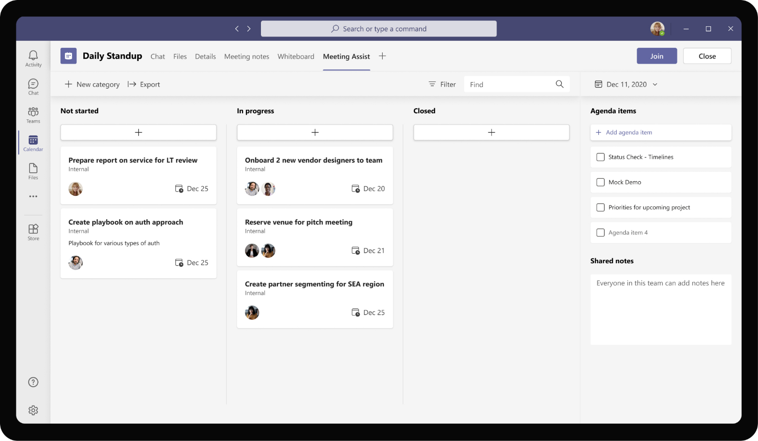
Cross-Industry– Meeting Manager
The app gets added to meeting’s context and pulls in the tasks assigned to the invitees in the meeting. Daniela can also cycle through dates to set agenda for subsequent instances of the meeting.

Slide 35
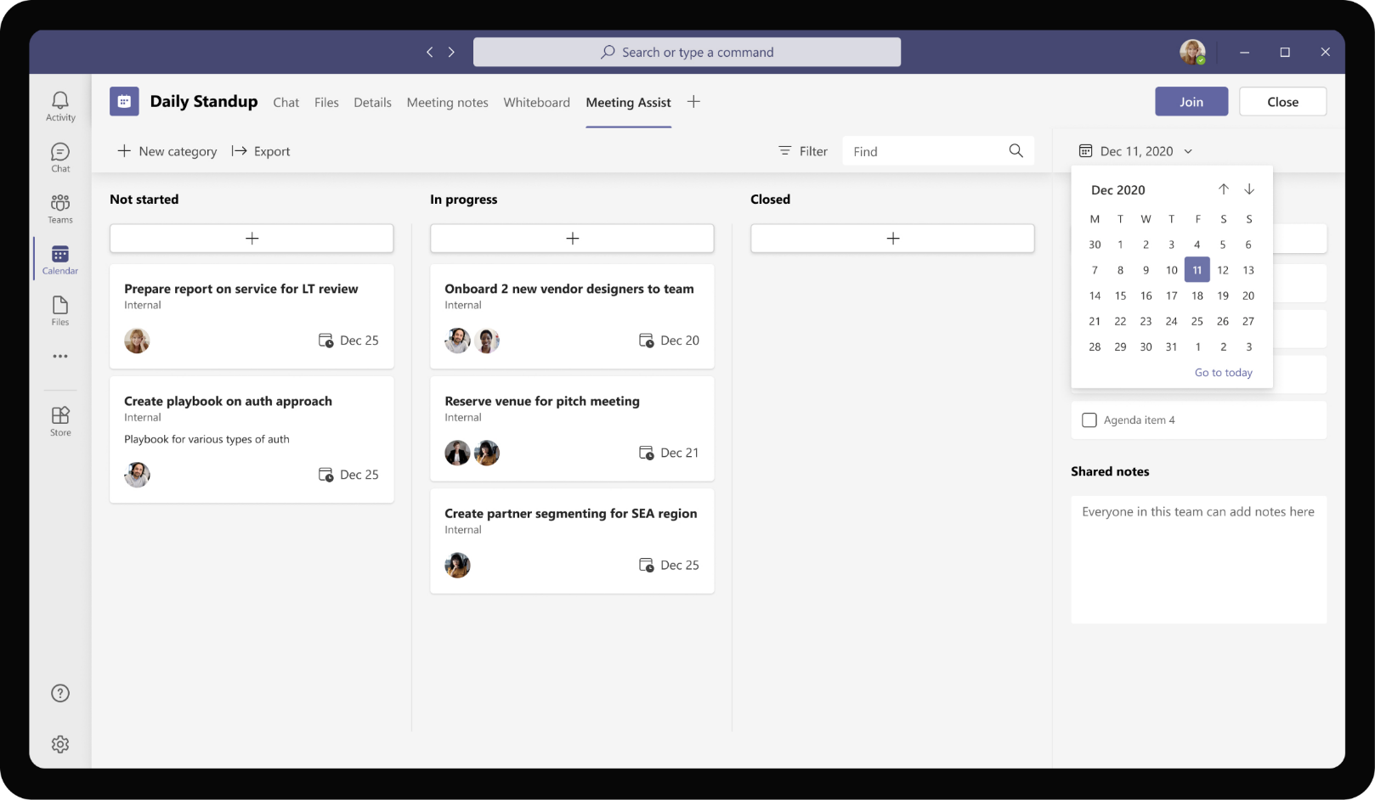
Cross-Industry– Meeting Manager
The app gets added to meeting’s context and pulls in the tasks assigned to the invitees in the meeting. Daniela can also cycle through dates to set agenda for subsequent instances of the meeting.

Slide 36
During the meeting, Daniela and rest of her team members can use the app in meeting scope to jot down important points discussed and create action items to be tracked

Slide 37
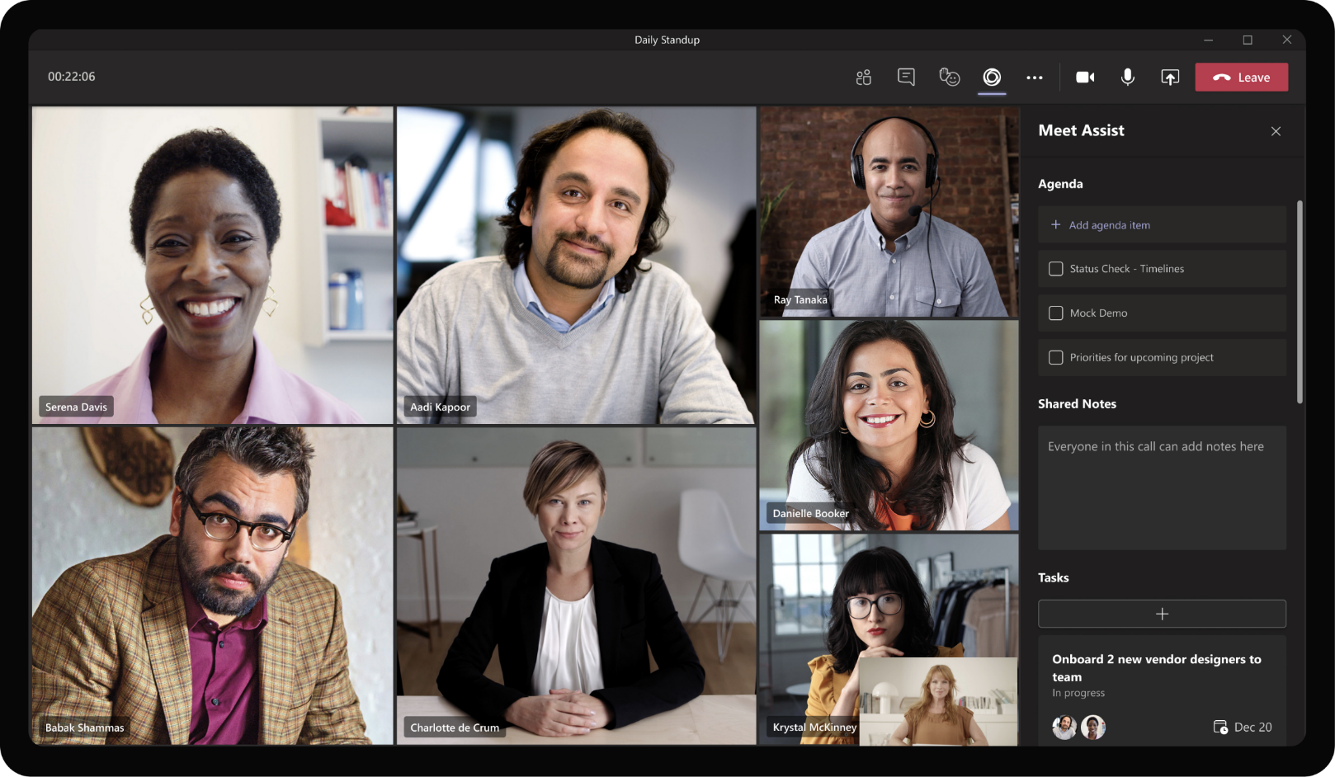
Cross-Industry– Meeting Manager
As the meeting starts, Daniela gets to view the agenda items and she has edit permissions to check agenda items completed. For other attendees in the meeting, agenda is displayed as a read only section.

Slide 38

Cross-Industry– Meeting Manager
As the meeting starts, Daniela gets to view the agenda items and she has edit permissions to check agenda items completed. For other attendees in the meeting, agenda is displayed as a read only section.

Slide 39
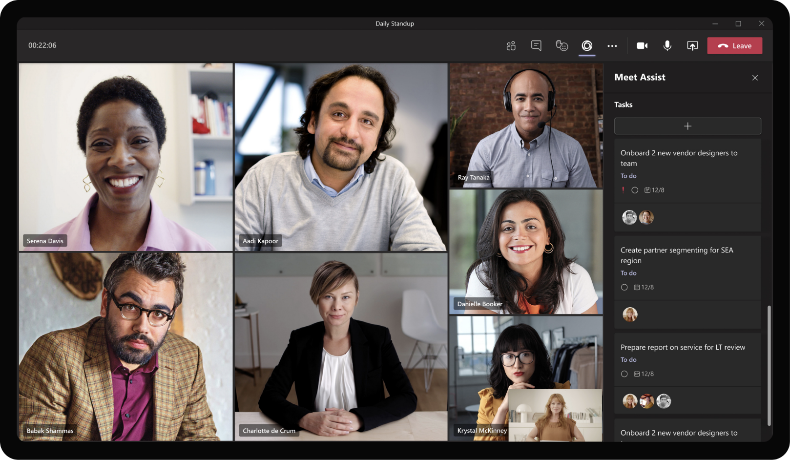
Cross-Industry– Meeting Manager
All participants in the meeting have the ability to cycle through open tasks assigned to team members and discuss about the same during the meeting.

Slide 40
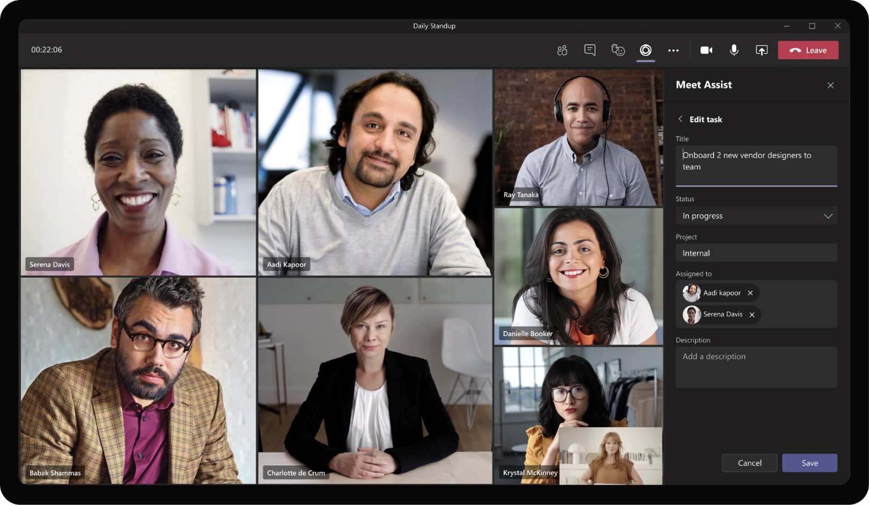
Cross-Industry– Meeting Manager
In addition to viewing tasks, all attendees in the meeting can also create ad hoc tasks based on action items that is discussed in the meeting.

Slide 41

Cross-Industry– Meeting Manager
Attendees can also change the progress of new / existing tasks

Slide 42

Cross-Industry– Meeting Manager
Once the task title, status and other information is entered along with task owners, task gets generated.

Slide 43

Cross-Industry– Meeting Manager
The newly created task gets added to the list of existing tasks and automatically added to Team’s Planner for everyone in the team to track progress.

Slide 44
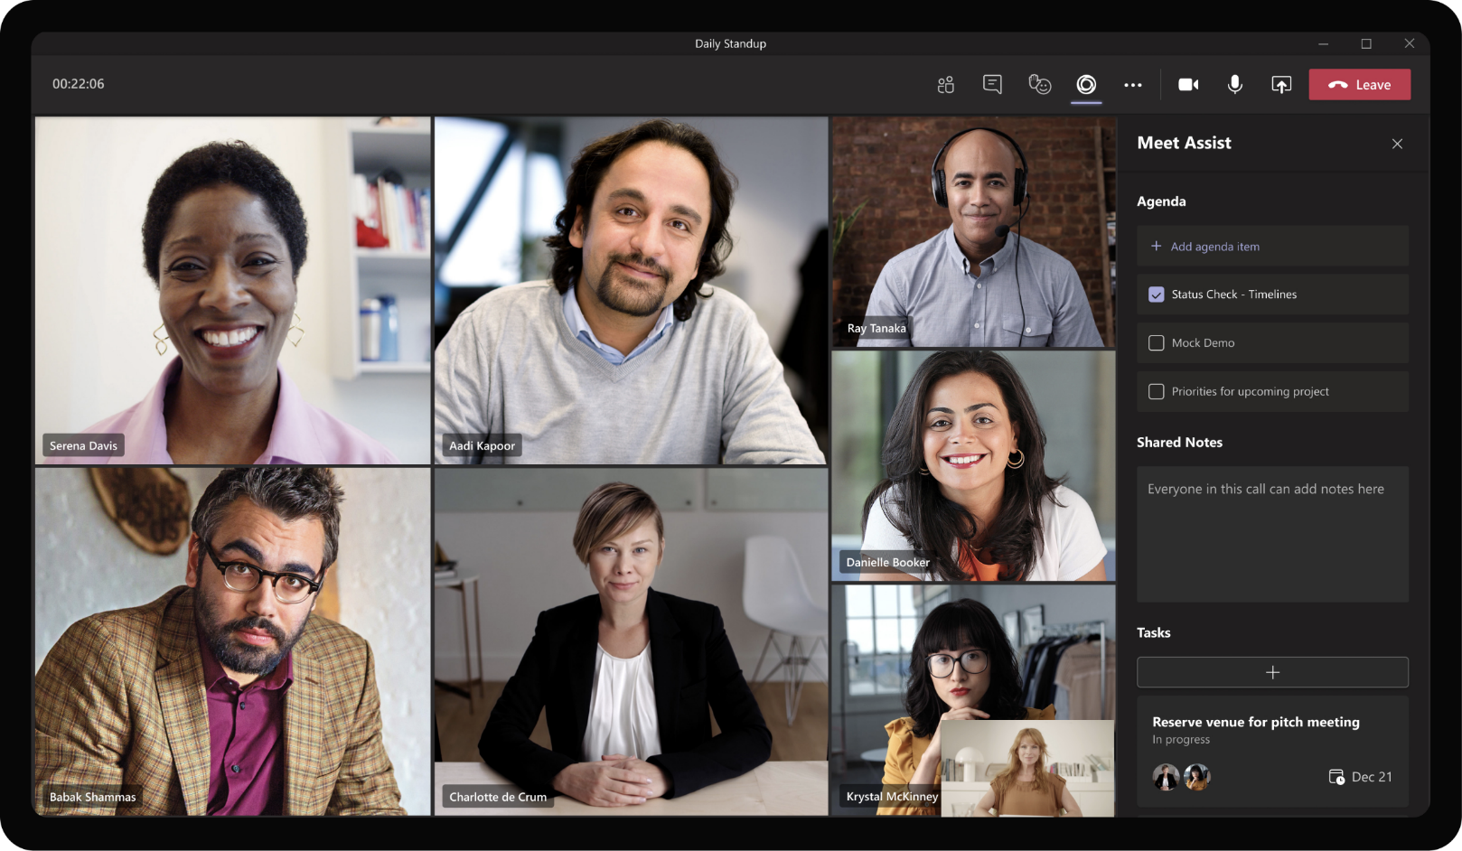
Cross-Industry– Meeting Manager
The side panel also has a section to add meeting notes.

Slide 45
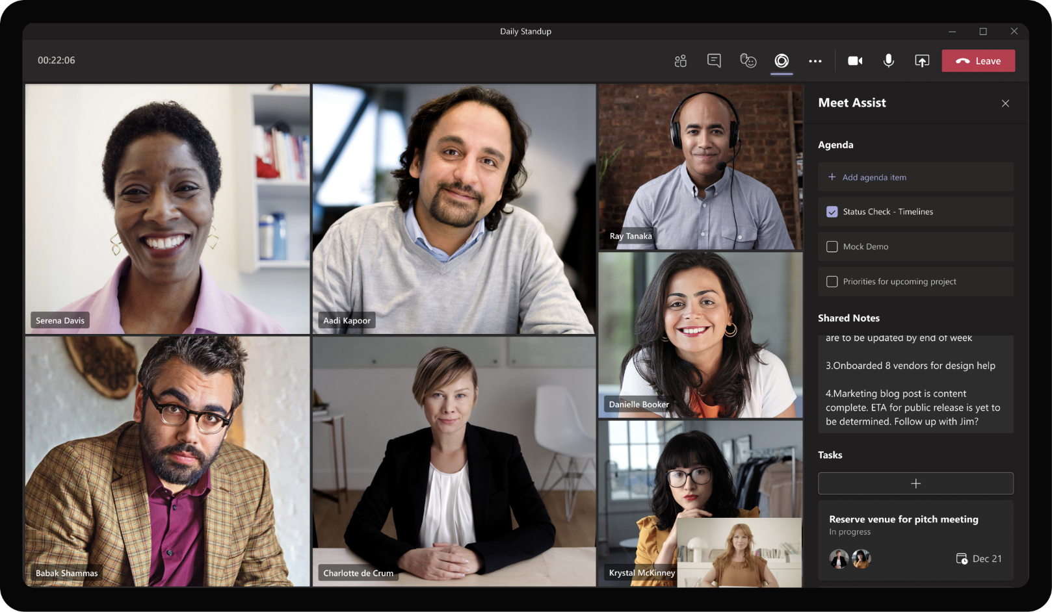
Cross-Industry– Meeting Manager
All participants in the meeting are empowered to add meeting notes during the meeting in their own side panel and not switch context to other tools.

Slide 46
All action items created and notes documented by the team get neatly collated and available in the channel for everyone’s consumption.

Slide 47
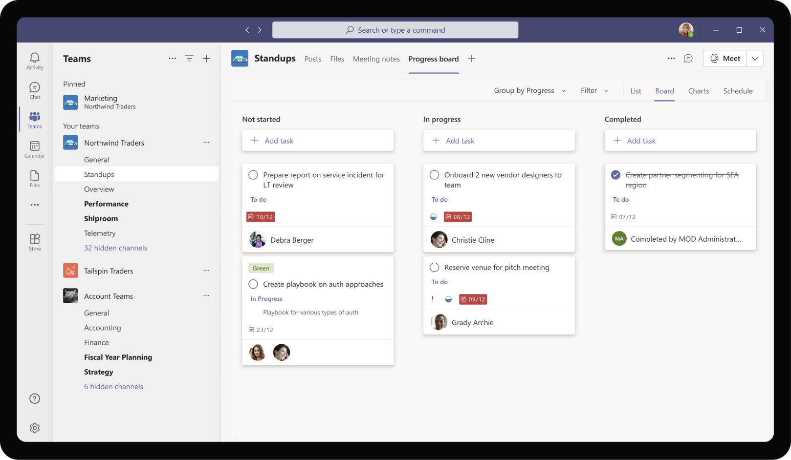
Cross-Industry– Meeting Manager
The tasks created during the course of each instance of the ‘Daily Standup’ meeting are shown in the Planner board pinned as a tab in the Standups channel.

Slide 48
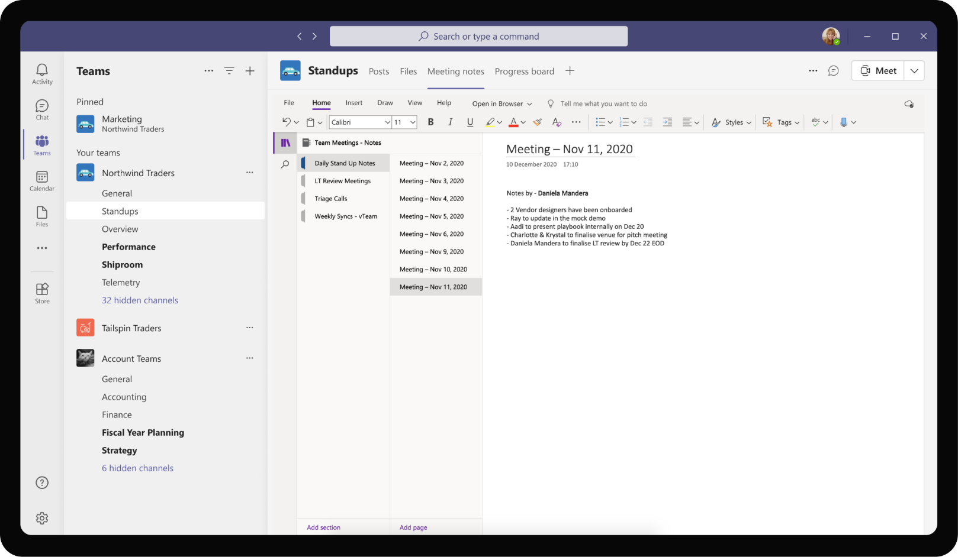
Cross-Industry– Meeting Manager
All notes taken during the meeting are also neatly collated with each meeting’s notes separated as different pages within a section in One Note.

Slide 49
Solution Highlights – Best Practices
Cross-Industry– Meeting Manager
Key Solution Design Considerations
Platform Extension Points
User Experience
Meeting & Team Scope: The app is useful in a collaborative perspective, in the context a meeting and within channel where team members collaborate with each other.
Messaging extension is the entry point for invoking the app as the meeting creation experience may happen in 1:1, group or in the flow of channel conversations.
Apps in meetings play crucial role as predominant part of the interaction between app and user happens before and during a meeting, in the context of a meeting.
App reuses existing elements of One Note and Planner to provide a consistent and familiar user experience for enterprise employees who already know these apps.
Task module is used for initiation of meetings due to the UI flexibility that it offers in terms of fetching availability across added attendees, uploading files and interactively adding agenda items
Meeting side panel is used predominantly to keep users in the flow of meetings while still providing them a way to capture discussion items. Seamless transition between personal space on the side panel and collaborative space on the meeting enhances user productivity.
Graph API
The app utilizes OneNote Graph APIs to retrieve notebook, create pages and sections and insert notes created by each attendee during the meetings.
Planner Tasks Graph APIs are used to create tasks in the To Do list for the signed in user.
The app also uses Create Event Graph API to create Teams calls between Daniela and her team members and Calendar Graph APIs to read and show calendar events

Slide 50

Solution Architecture
Cross-Industry– Meeting Manager
Azure Subscription
Graph API
AAD
External Systems
SSO & User IDs
OneNote, Planner
Create pages, insert content
Bot / Task Module / ME
Meeting coordinates
OneNote Notebook
Employee
MS Teams
Bot Registration
Meet Assist
App Service
GET / POST Meeting info
Create Tasks
Planner Tasks
Meetings Database

Slide 51
Employee Onboarding
Cross-IndustryBook of Dreams

Slide 52
Scenario Vision
Employee
Context
Reta, a new hire at Contoso services is looking forward to joining her new job post college. Unfortunately, due to a global pandemic, the onboarding has been modified to be conducted in remote manner over Teams calls, and channels
Daniela, HR manager at Contoso would like to provide a great onboarding experience for Reta and rest of the new hire batch, at par with the in-person onboarding sessions they have conducted the past few years.
Current State
Reta gets an e-mail from Contoso HR Team confirming her onboarding sessions and a link to update her HR profile
Reta’s team manager sends another e-mail asking Reta to write a fun introduction about herself which they will then post on New Hire Introductions channel
Reta gets added to a mailer group of new hires in her batch. The new hires get introduction blasts of their colleagues and reply all to reach everyone.
The emailer list quickly spins out of control as a lot of new hires try to ask questions and get answers from everyone else. Reta finds it very difficult to keep track of conversations and updates over e-mails.
Outside the mailer list, Reta also receives frequent reminders about trainings, new hire pack of information, and NDA to sign
Post a couple of days, Reta is assigned a buddy who gets introduced over e-mail and they get to chat and meet up over Teams
Every few weeks, Contoso sends an e-mail to fill up onboarding survey with a few reminders spamming Reta’s mailbox.
Future State
Daniela logs in her Teams app to access the knowledge base. She uses the app to search for assets available in the organization
Since the assets are tagged with meta data and categorized in logical groupings, Daniela is able to quickly find materials useful for her industry and type of project
The app takes as input Daniela’s need after a series of questions. Based on her responses, the app intelligently surfaces the latest version of relevant assets that Daniela can use in her customer conversations.
In addition to providing these assets, the app also provides a comprehensive list of SMEs in each domain based on the contributors information that it maintains
Daniela can use the app to submit assets for review by central team. Daniela provides useful context around the asset and submits using the app. Based on the type of content submitted, the app submits it to right team for review
Daniela gets to see real time updates of the content review and approval.
- Points of Friction

Slide 53

Reta Taylor, New Hire
Daniela is a new hire at Contoso Services who will be joining the team Northwind Traders. She is a college grad and is eager to learn and grow in her first job out of college.

Slide 54
Reta has joined Contoso team recently and is waiting to be onboarded. As she gets her work device and sets up Teams, she has a message waiting for her from HR Tools app.

Slide 55
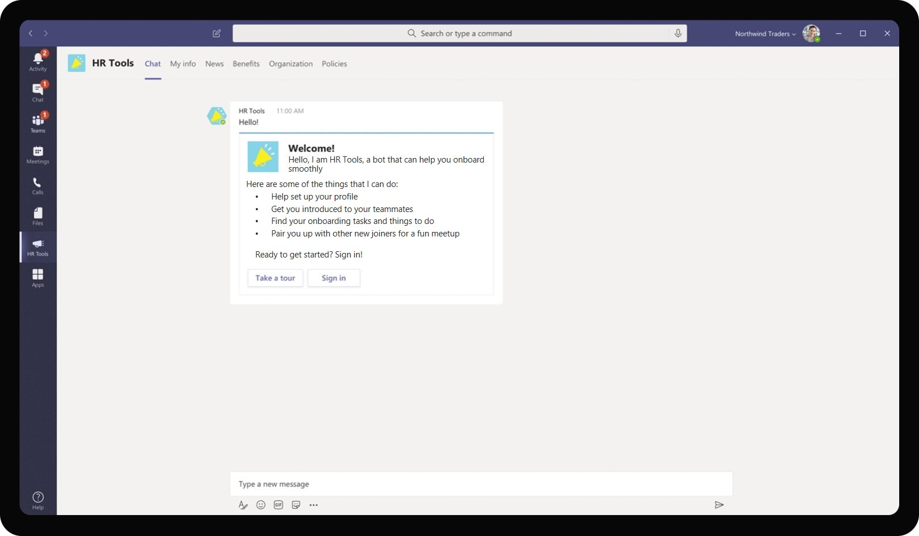
Cross-Industry– Employee Onboarding
The app welcomes Reta into the firm and team and provides her with a list of helpful suggestions, actions that the app can do for her. It also prompts her to sign in to move forward.

Slide 56
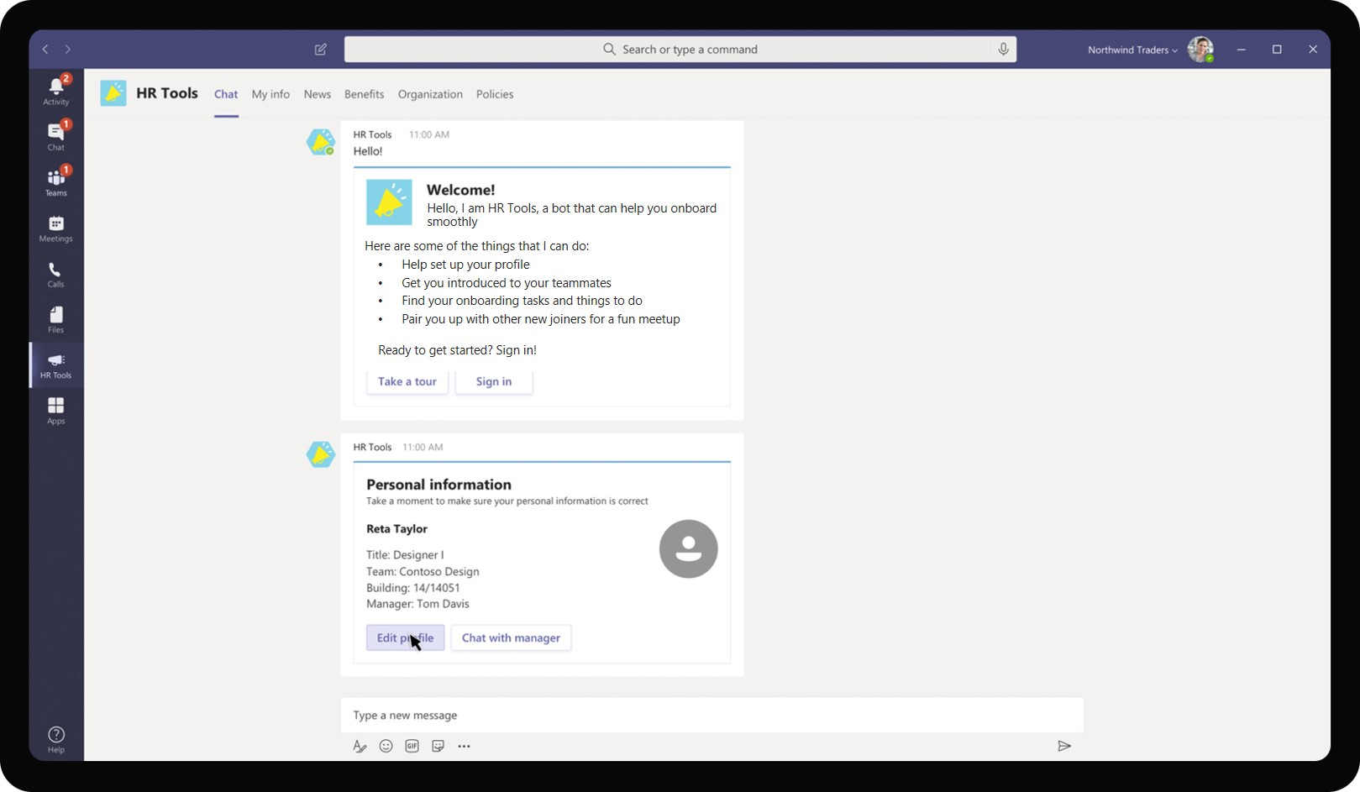
Cross-Industry– Employee Onboarding
As Reta signs in, the app provides her with a summary information of her profile which has some pending information to be updated. It asks Reta to proceed to update it right within the app.

Slide 57
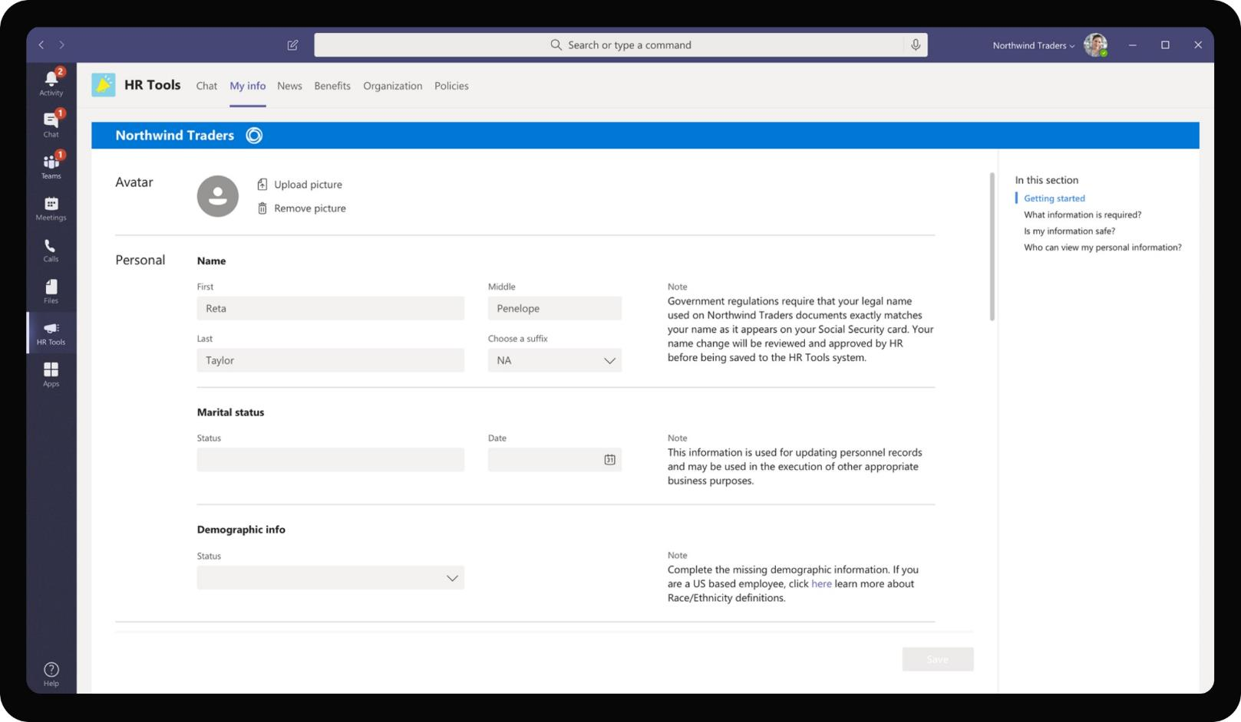
Cross-Industry– Employee Onboarding
Once Reta clicks on Edit Profile, the app redirects her to a tab called ‘My Info’ which has fields for Reta to validate and complete as part of her HR onboarding.

Slide 58

Cross-Industry– Employee Onboarding
The tab surface is interactive, clear and guides Reta to each step of filling her profile with useful tips around any FAQs she might have. Reta uses the tab to upload her profile picture using a file that she has on her device.

Slide 59
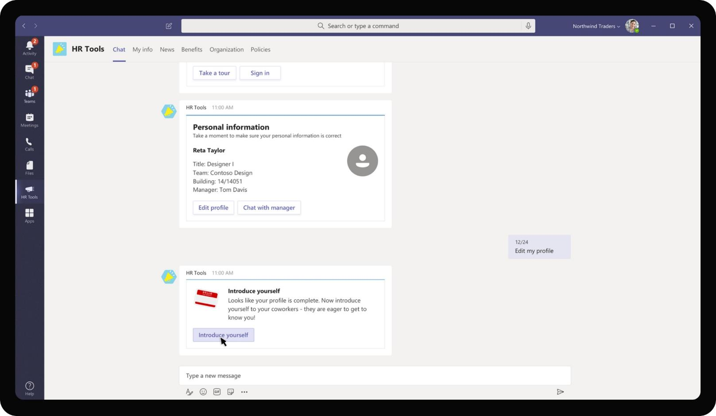
Cross-Industry– Employee Onboarding
Once Reta completes filling her HR profile formally for HR records, the app provides another space for Reta to introduce herself informally to her co-workers.

Slide 60
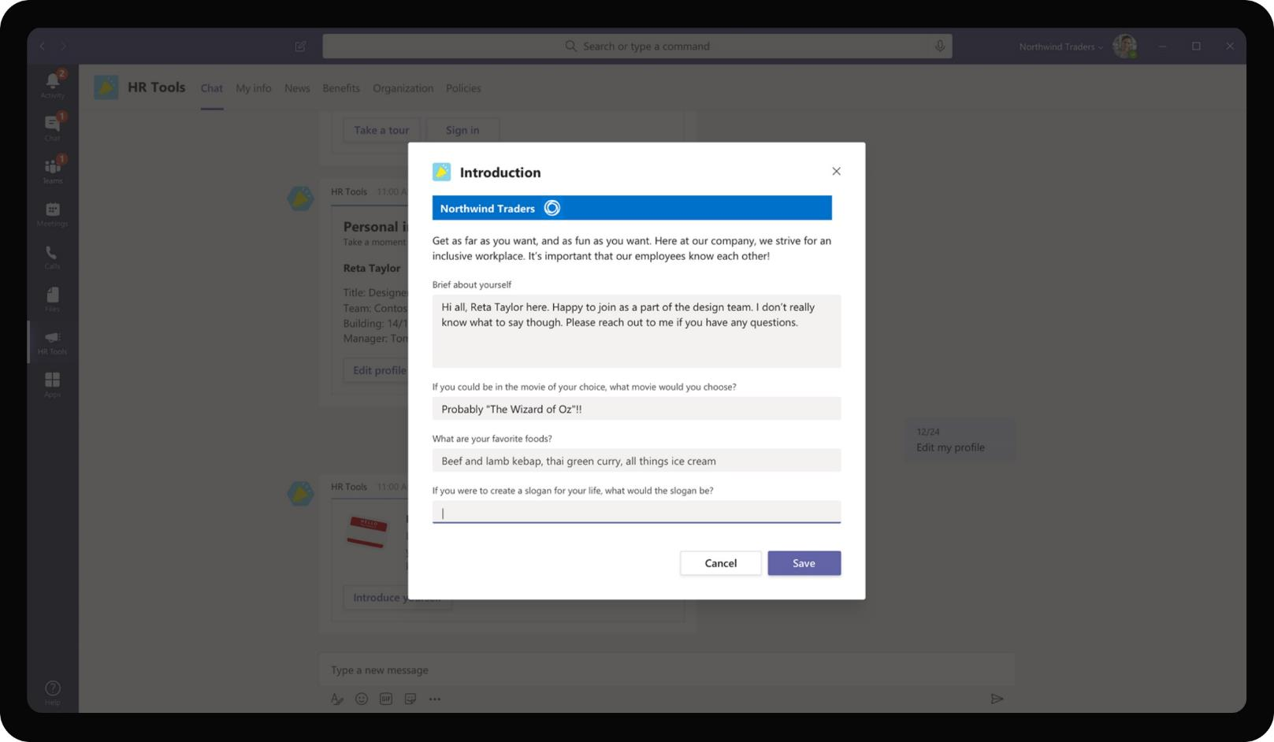
Cross-Industry– Employee Onboarding
As Reta clicks on the Introduce button, it opens a pop up dialog box asking fun, informal questions about her. In this way, the app gets a templatized version of intros provided to the Team whenever a new person joins the team.

Slide 61
Daniela Mandera, HR Manager
Daniela is a HR manager at Contoso Services and takes care of hiring for multiple teams within Contoso. She oversees hiring, negotiations, onboarding for new hires and new hire training.

Slide 62
Daniela, the HR manager in Contoso gets the completed profile information of all new joiners. Daniela may review the introductions submitted and approve

Slide 63
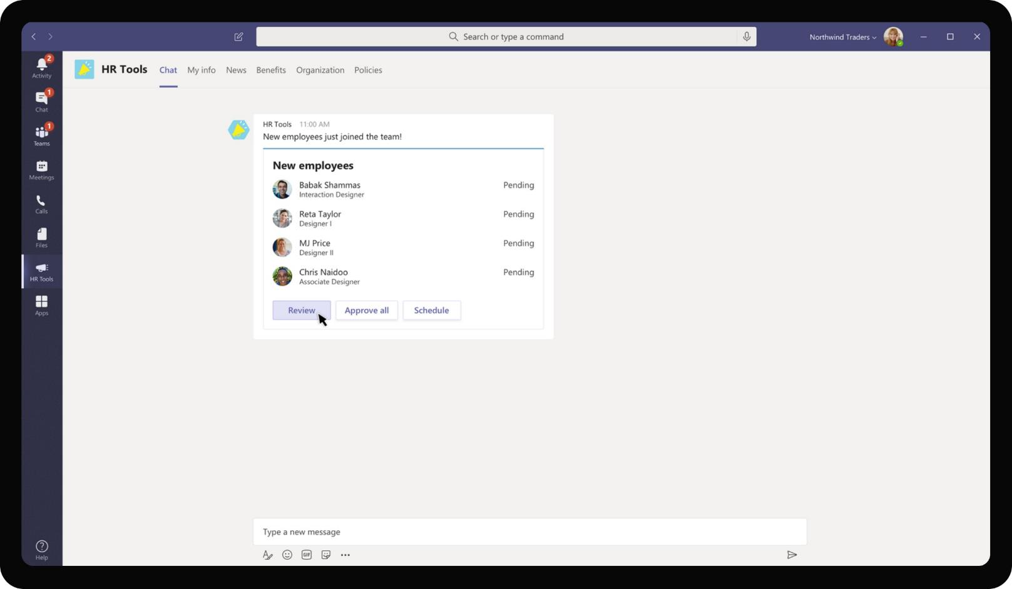
Cross-Industry– Employee Onboarding
HR Tools app for Daniela shows a different set of information for HR Managers. Since Daniela is a HR Manager, she gets to view the new employees who joined the team and review the introductions that were submitted by them.

Slide 64
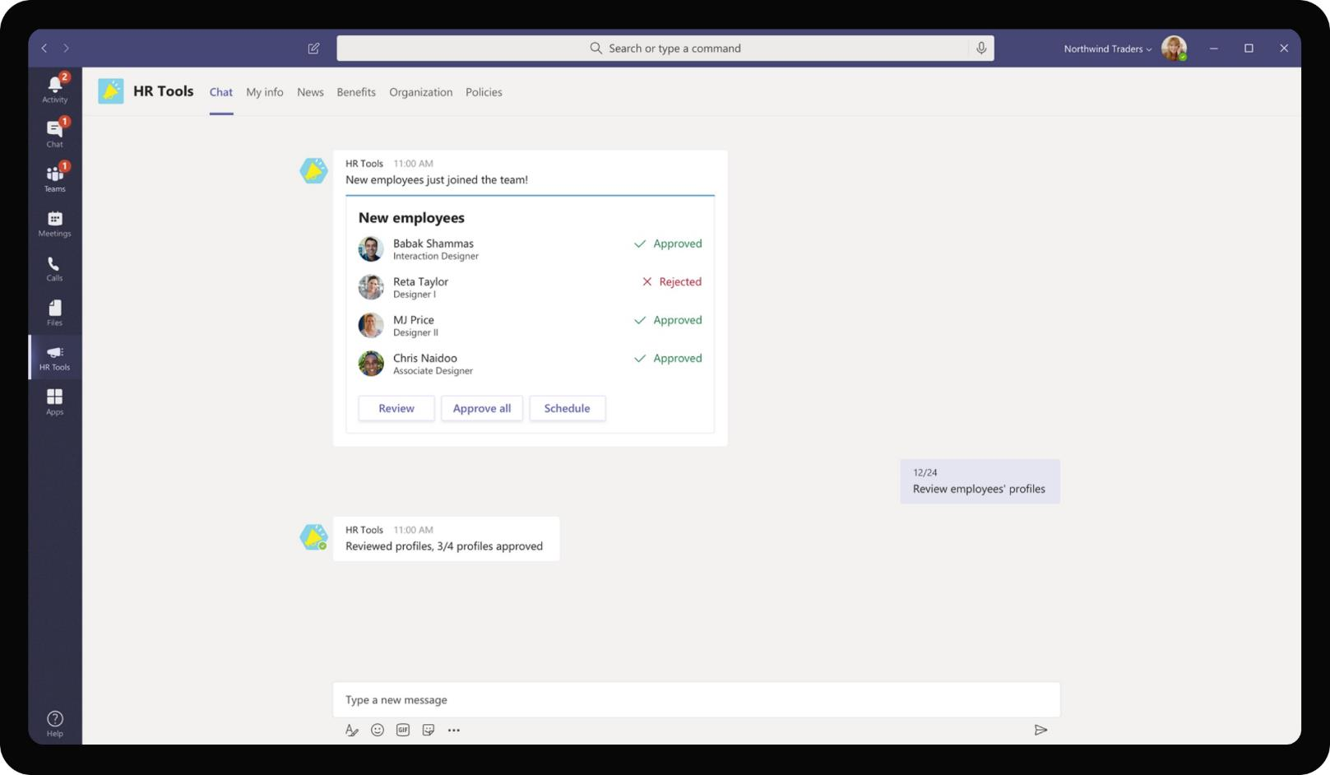
Cross-Industry– Employee Onboarding
Daniela may review the introductions submitted within the app, and reject the ones that might need some additional information. Employee whose introduction was rejected is requested by the app to resubmit

Slide 65
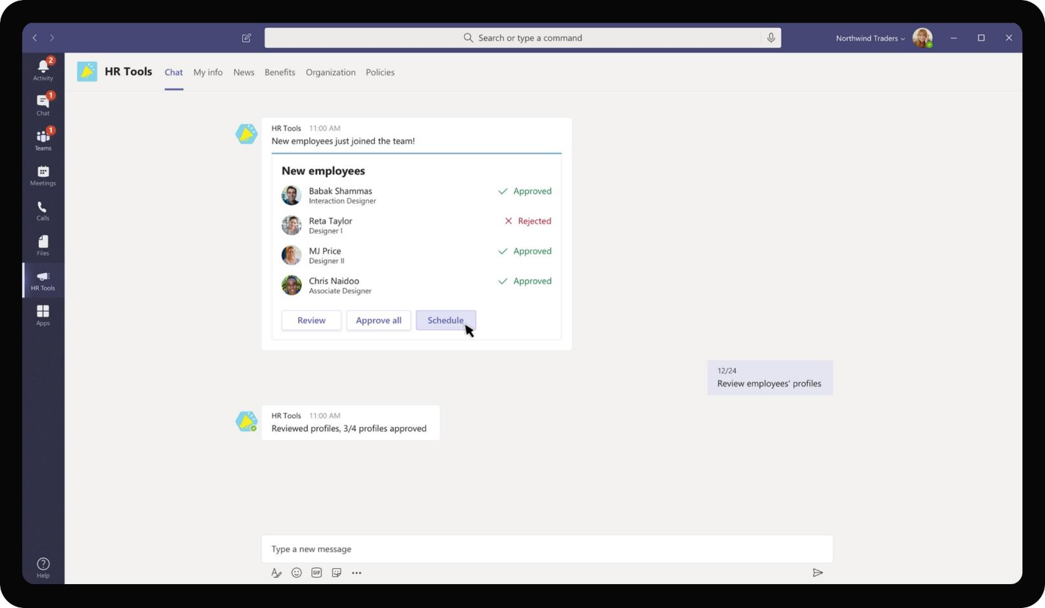
Cross-Industry– Employee Onboarding
Once Daniela has reviewed the applications, she proceeds to schedule a post covering the introductions of new joiners. This post will be shared by the app in the Teams that new joiners will be added to.

Slide 66
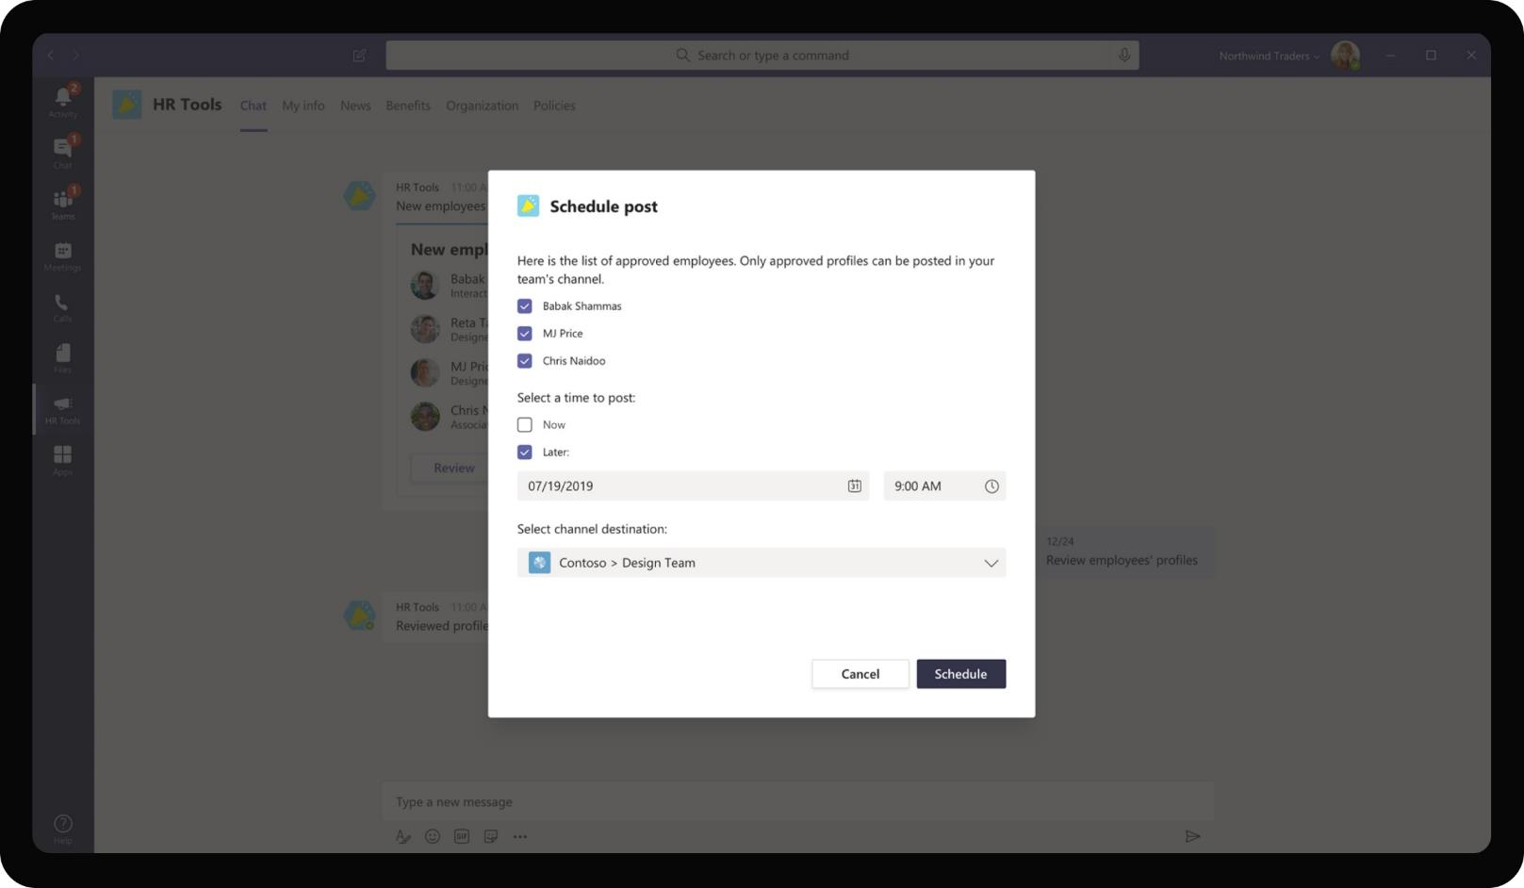
Cross-Industry– Employee Onboarding
Once Daniela has reviewed the applications, she proceeds to schedule a post covering the introductions of new joiners. This post will be shared by the app in the Teams that new joiners will be added to.

Slide 67
On the second day of onboarding, Reta gets invited to join a Team with other new employees who joined Contoso in the same batch

Slide 68
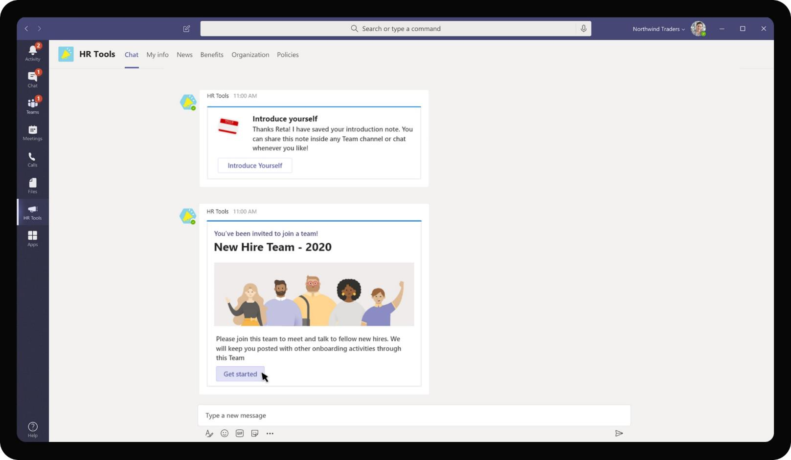
Cross-Industry– Employee Onboarding
The app prompts an invite for Reta to join a New Hire Team of 2020 which will have other employees who joined in the same time frame as Reta but across different teams and business units.

Slide 69
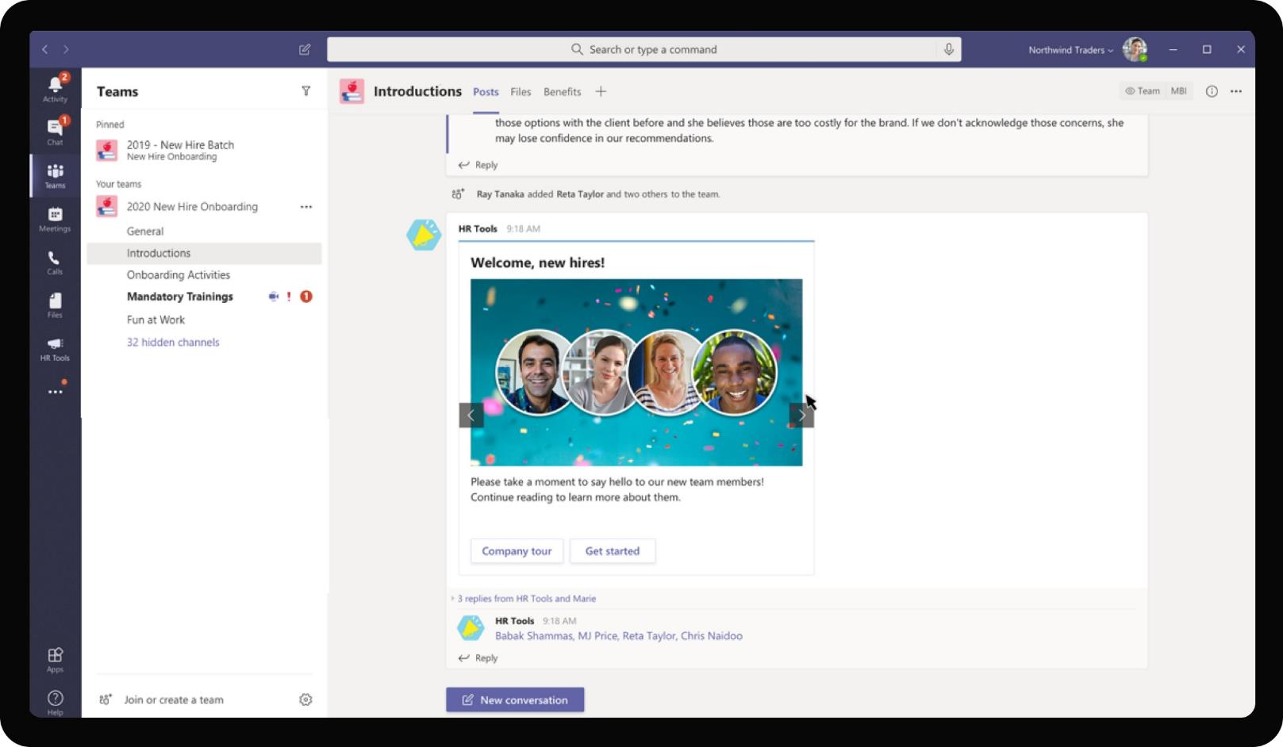
Cross-Industry– Employee Onboarding
As Reta joins the team, she is greeted with Introductions of fellow new hires and the app posts introductions of each other in regular intervals for employees to get to know each other.

Slide 70
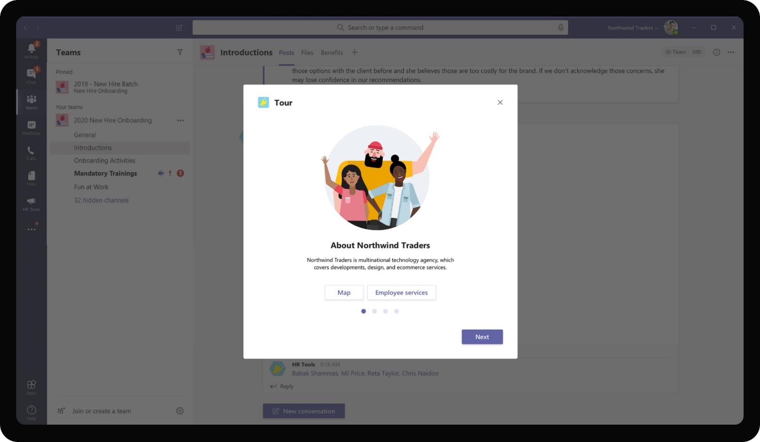
Cross-Industry– Employee Onboarding
All information relevant for new hires is pushed by the app within this Team. Employees get to discover information about Contoso, HR services, trainings together with other employees promoting a feeling of community.

Slide 71
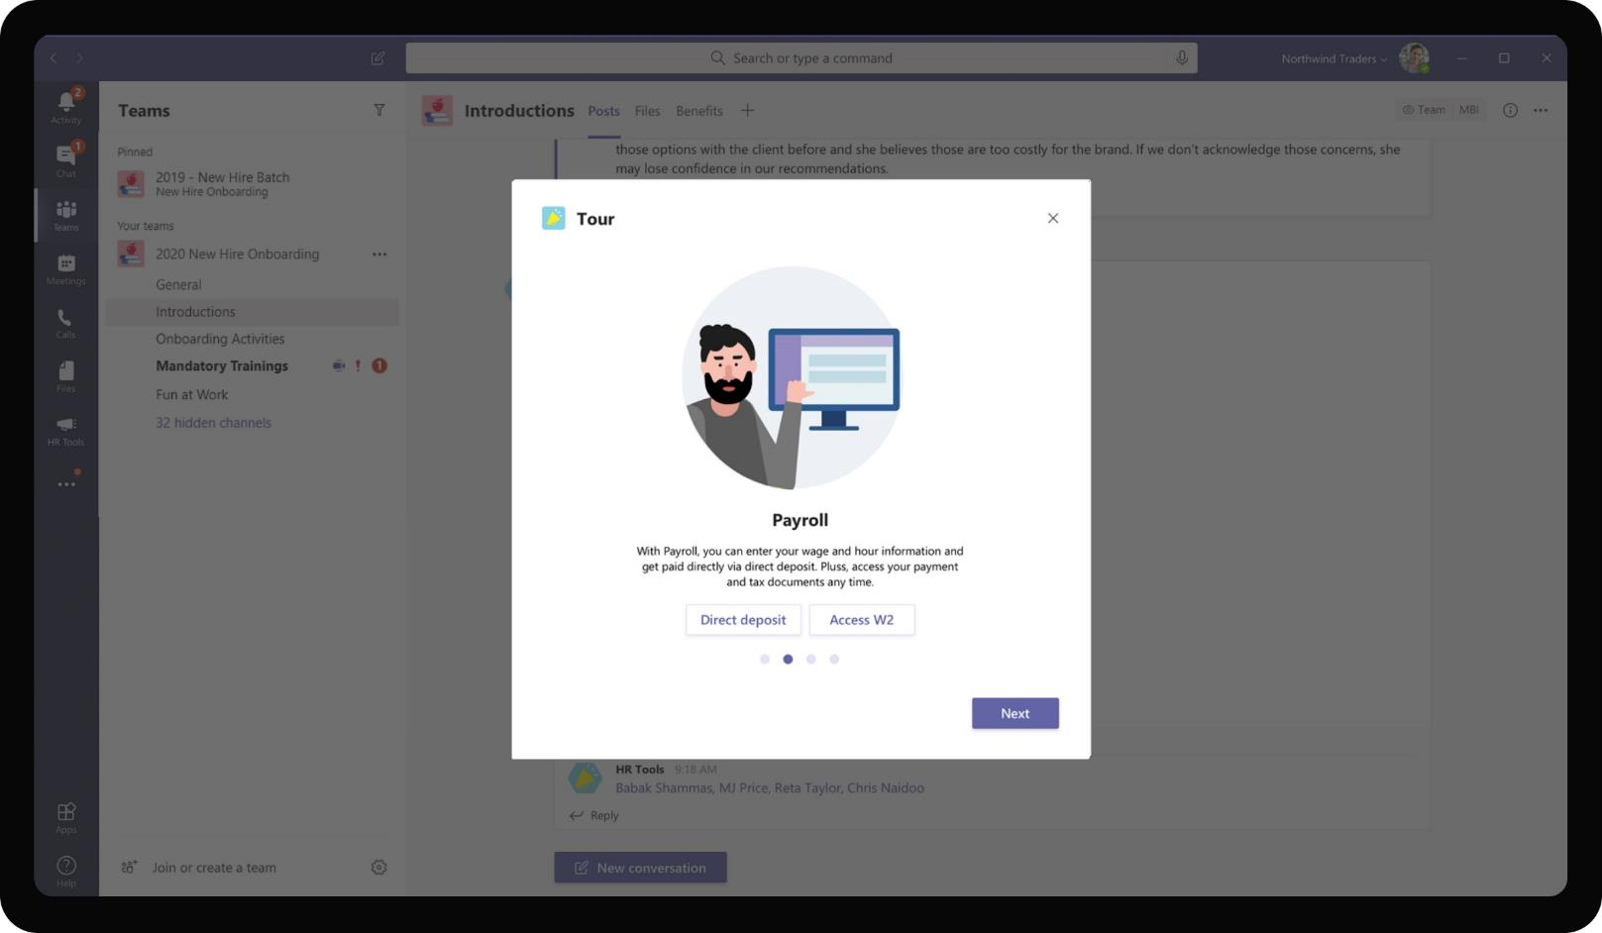
Cross-Industry– Employee Onboarding
All information relevant for new hires is pushed by the app within this Team. Employees get to discover information about Contoso, HR services, trainings together with other employees promoting a feeling of community.

Slide 72
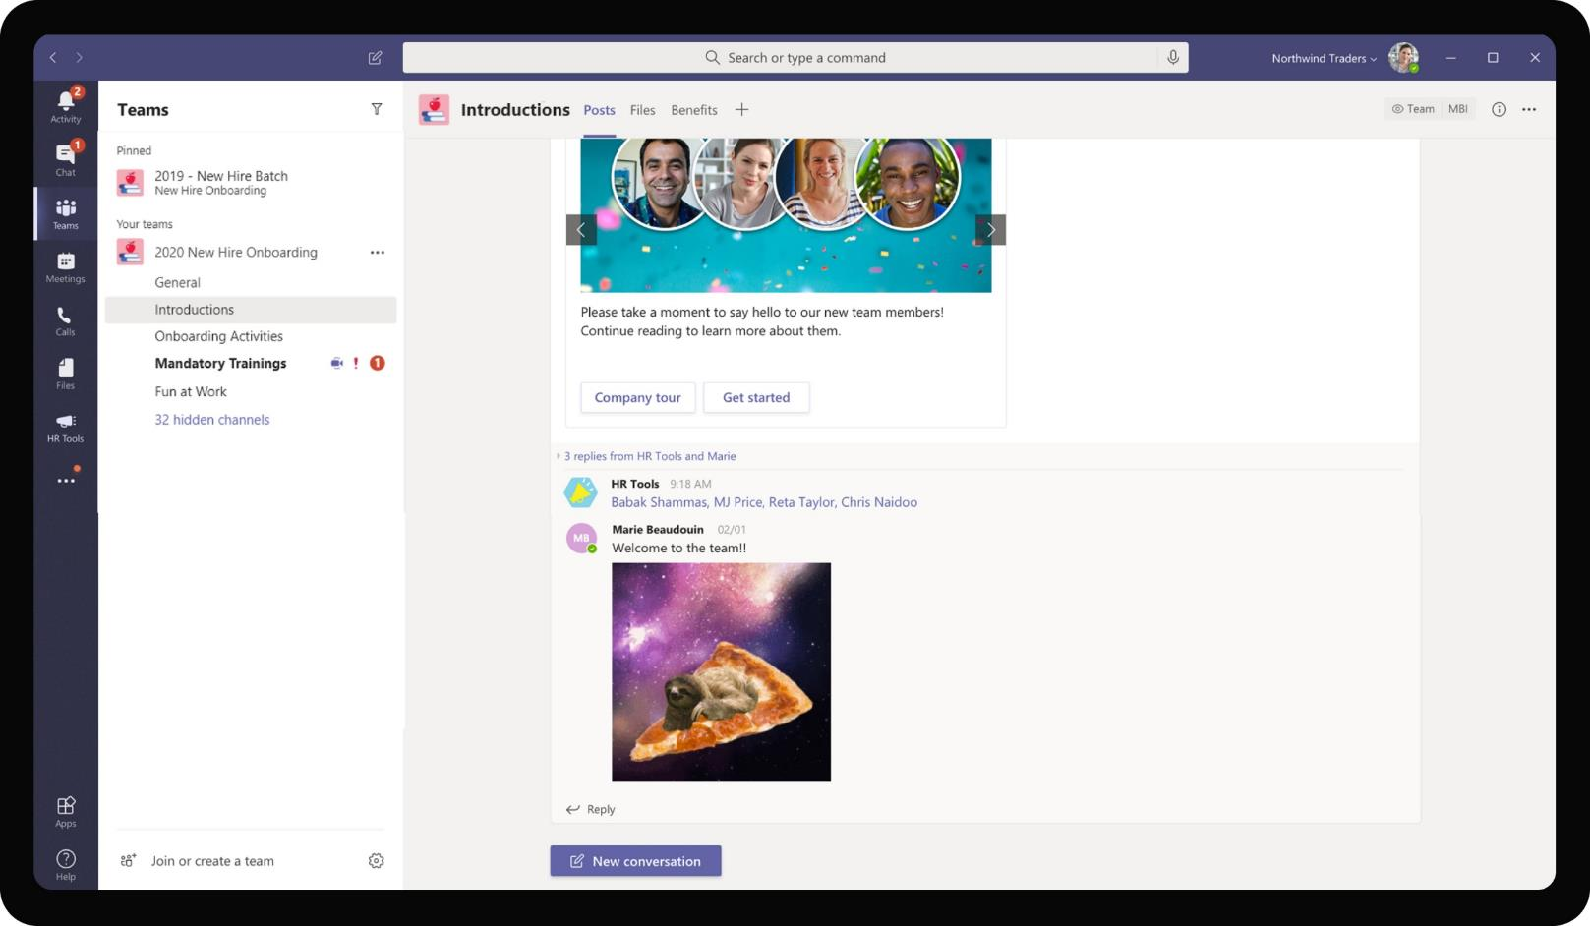
Cross-Industry– Employee Onboarding
New Hires from different teams who might otherwise not interact with each other, also get to meet and know about different teams. This promotes culture of establishing connections and drives One Contoso value.

Slide 73
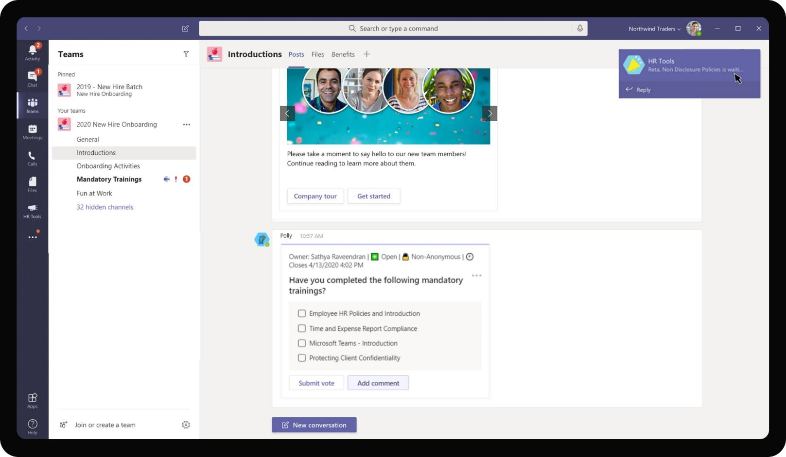
Cross-Industry– Employee Onboarding
HR Managers can send polls to check if new hires have completed their mandatory trainings in an efficient manner. New hires can also discuss about trainings, to do action items in the channel. Reta, as a new hire, gets a notification reminder to complete her NDA signing.

Slide 74
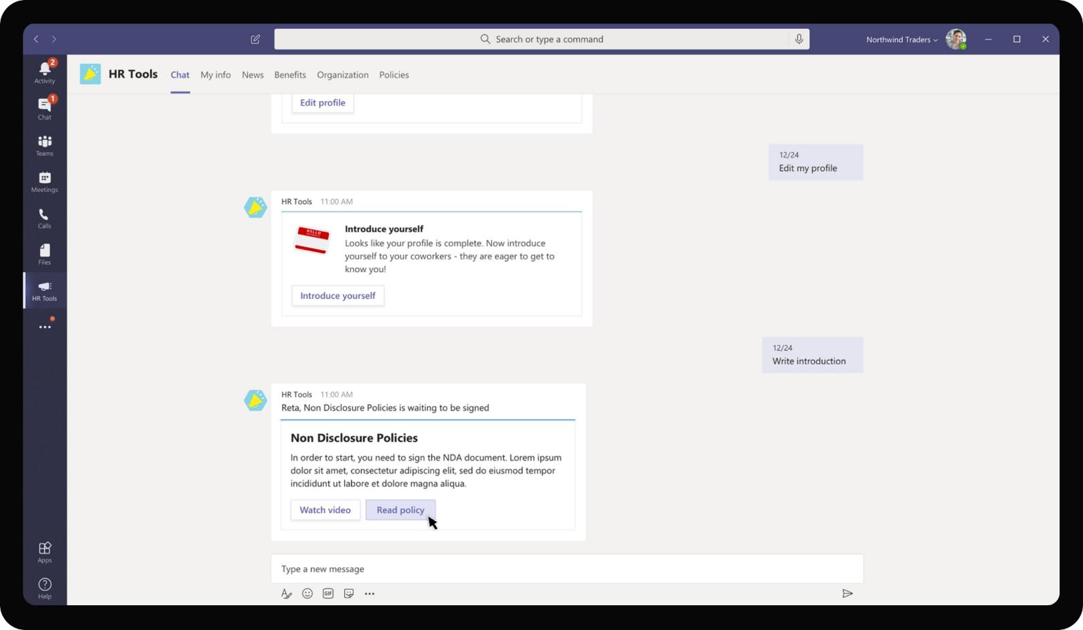
Cross-Industry– Employee Onboarding
Clicking on the notification takes Reta back to her personal scope. The bot provides a message with options to view the NDA and requesting Reta to sign the name.

Slide 75
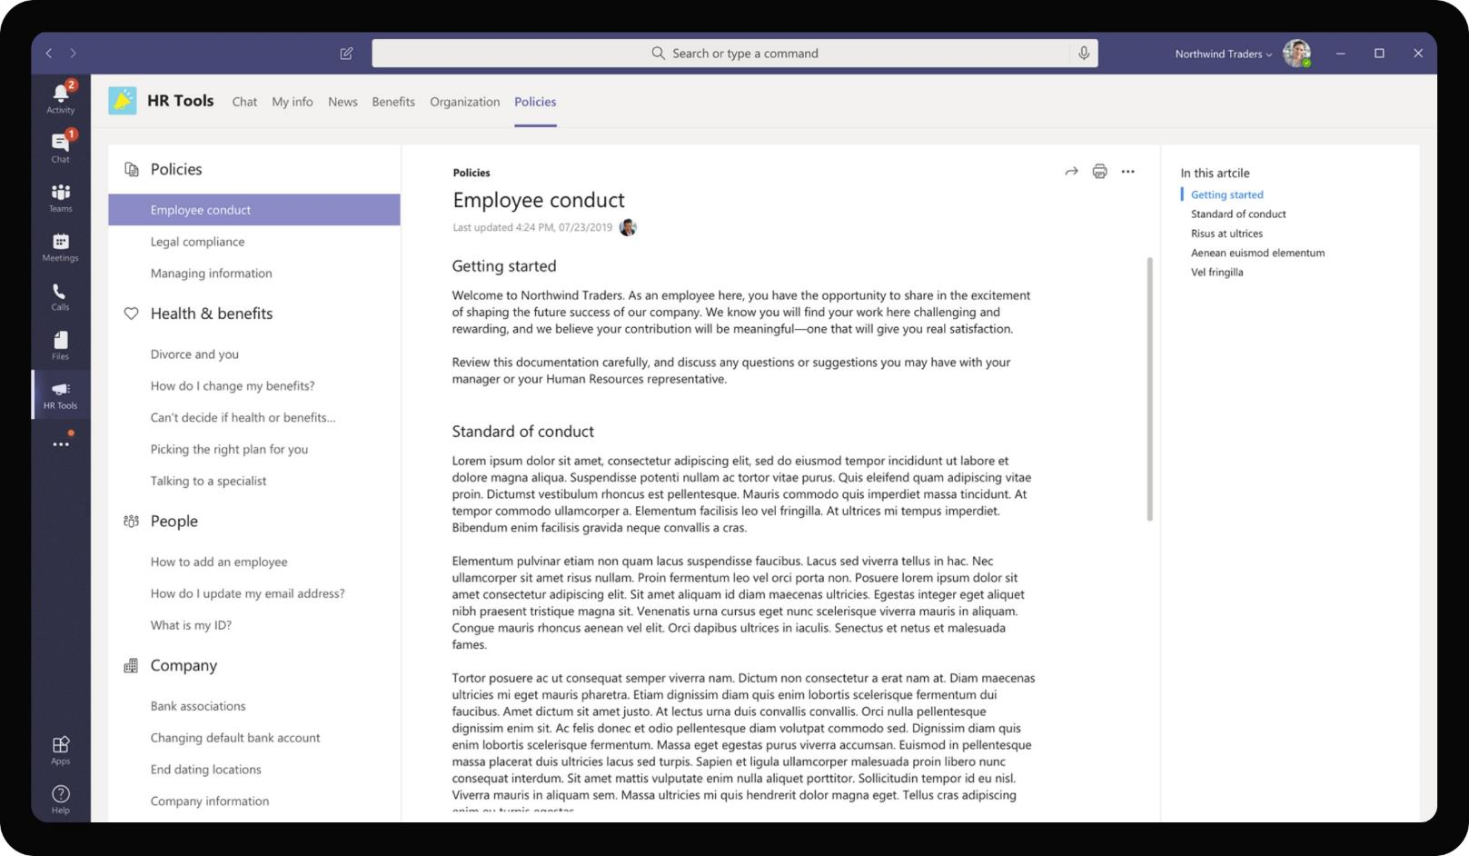
Cross-Industry– Employee Onboarding
Clicking on view NDA, Reta is taken to tab marked Policies which walks her through various sections of the NDA. Reta may continue reading the NDA and sign as an acknowledgment at the end

Slide 76
At the end of first 10 days, 30 days and 60 days of onboarding, the app sends respective surveys to check on the new hires

Slide 77
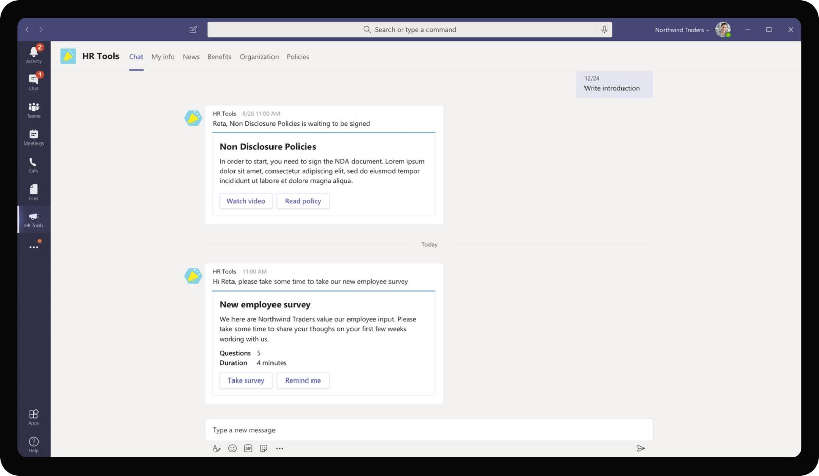
Cross-Industry– Employee Onboarding
As Reta starts to work on her day to day responsibilities, the app sends periodic surveys to assess onboarding effectiveness, Reta’s comfort quotient with the team and other relevant parameters

Slide 78
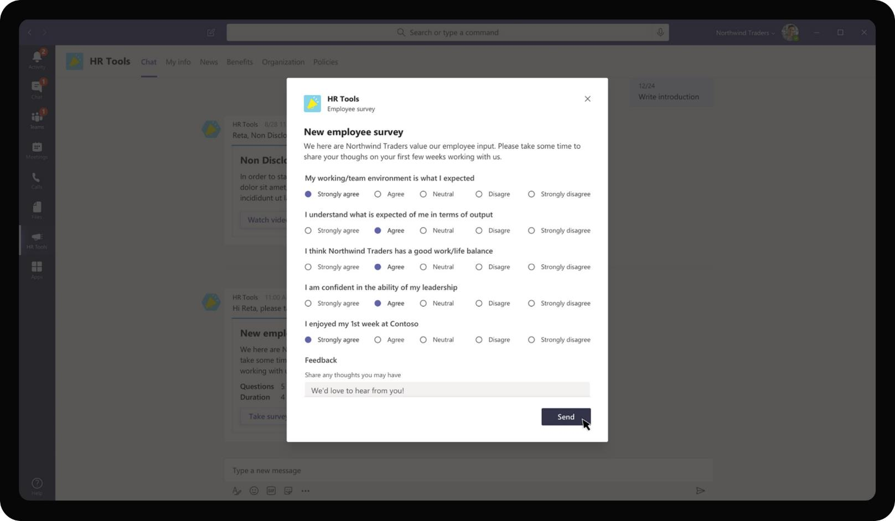
Cross-Industry– Employee Onboarding
As Reta starts to work on her day to day responsibilities, the app sends periodic surveys to assess onboarding effectiveness, Reta’s comfort quotient with the team and other relevant parameters

Slide 79
Daniela is able to view the results of the employee surveys in a central dashboard view

Slide 80
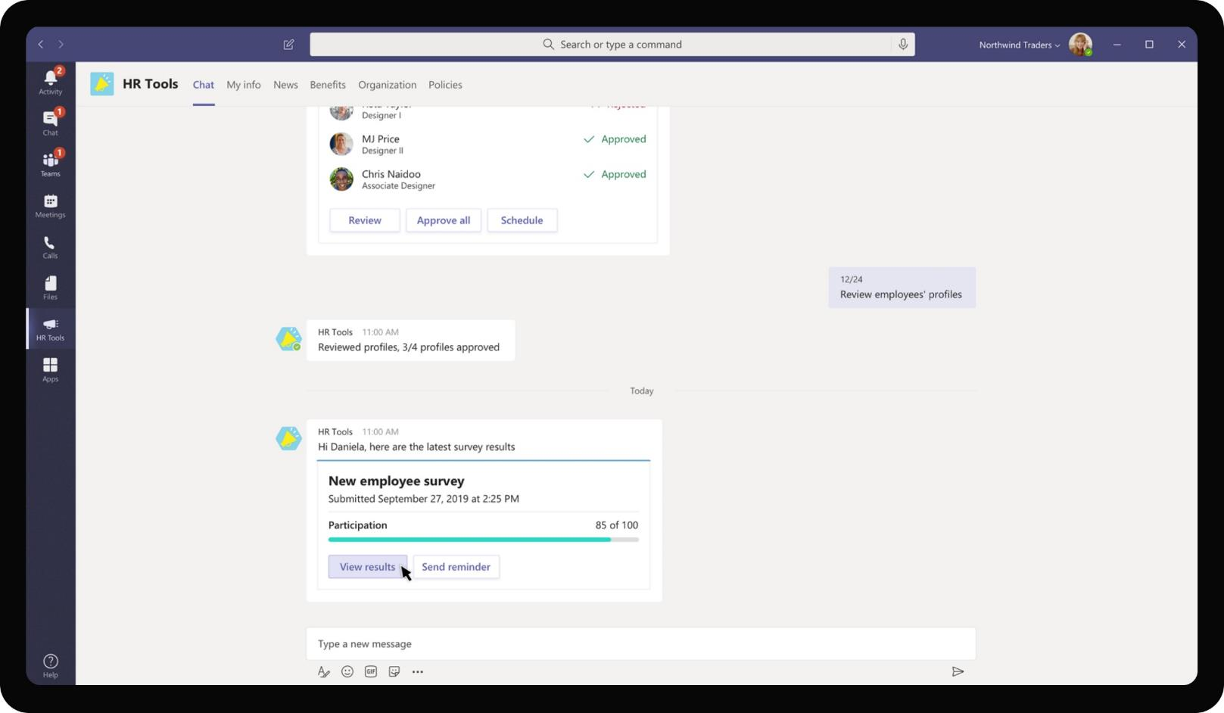
Cross-Industry– Employee Onboarding
As participants complete the survey, the results are communicated to Daniela to consume and work on feedback

Slide 81
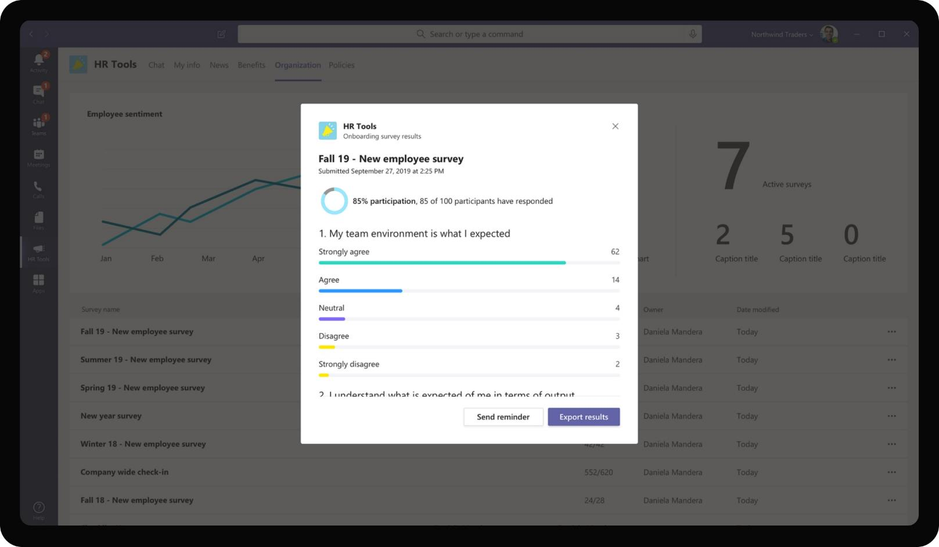
Cross-Industry– Employee Onboarding
Viewing the results provides Daniela with a dashboard view of responses the survey had received. The dashboard is configurable to provide quick insights for Daniela to act upon

Slide 82
During the course of onboarding, the app also provides a number of opportunities for Reta to ramp up and get integrated into her team quickly

Slide 83
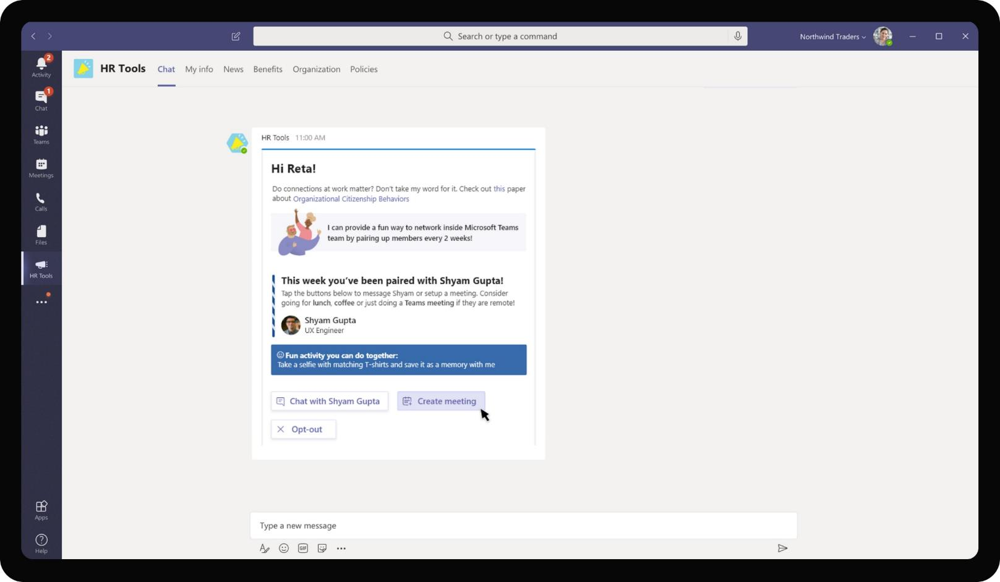
Cross-Industry– Employee Onboarding
The app pairs Reta with cross-team members from time to time to help grow her network

Slide 84

Cross-Industry– Employee Onboarding
At regular intervals, it prompts Reta to complete her Mandatory trainings

Slide 85

Cross-Industry– Employee Onboarding
Each training can be added as an event to Reta’s calendar to remind her. Clicking on a training provides more details around the venue, mode of delivery as well. For certain trainings, the app also allows registration directly from Teams.

Slide 86

Cross-Industry– Employee Onboarding
Employee onboarding app also proactively suggest Reta with Teams she can join based on the common teams of her closest collaborators

Slide 87
Solution Highlights – Best Practices
Cross-Industry– Employee Onboarding
Key Solution Design Considerations
Platform Extension Points
User Experience
Personal Scoped App: The app is designed to be predominantly personal scoped app (with personal tab and personal bot) because the information consumption experience is personal in nature. Onboarding format would be standard but the messages, teams, onboarding buddy, trainings, NDA documents are different for each employee. It works best to be communicated in each employee’s personal scope
Channel Scope Bot: The bot exists in both personal and channel scope. The channel scope element comes into play when posting introductions into a Team, creating a Team and adding new hires to the team.
Task Modules are used primarily to show intermediary steps to be done in a task without breaking the user flow. E.g. Filling survey questions, viewing additional details about the event.
Proactive Messages are sent for welcoming users and to send updates about teams, trainings, pairing with buddies and policy documents
List cards are used to show trainings and teams in one quick glance. This serves the purpose of collating all related in one unit as opposed to sending a separate card for each matching event.
Deeplinks are used to take the new hire from their personal bot chat to a Tab containing policy documents are to a newly joined Team.
Graph API
The app utilizes Add member to add new hires to a particular team
The app uses Workplace Intelligence Graph APIs to determine close collaborators and suggest Teams to join
The app also uses Create Event Graph API to create Teams calls with buddies. It also uses Calendar Graph API to add calendar reminders for trainings.

Slide 88



Solution Architecture
Cross-Industry– Employee Onboarding
Azure Subscription
AAD
External Systems
Manager
Client App (Survey Dashboard)
SSO and Reporting org
Bot / Task Module / ME
Employee info, bot CTAs
Employee Database
MS Teams
Bot Registration
Onboarding
App Service
Read Emp info, HR docs
GET Onboarding task info, intros
Employee
Client App (Policies, Profile Tabs)
HR Survey Table
Employee Onboarding Table

